Slide 1
Developing an integrated approach to the issues of drug use and homelessness – the experience from the frontline.
Mark Kennedy Head of Day Services, Merchants Quay Ireland

Slide 2
Today’s objectives
  What are they key points of interest for you from the inputs?
  How do you think these key points can be addressed?
  What 3 specific actions do we want to recommend that can feed into developing new NDS?

Slide 3
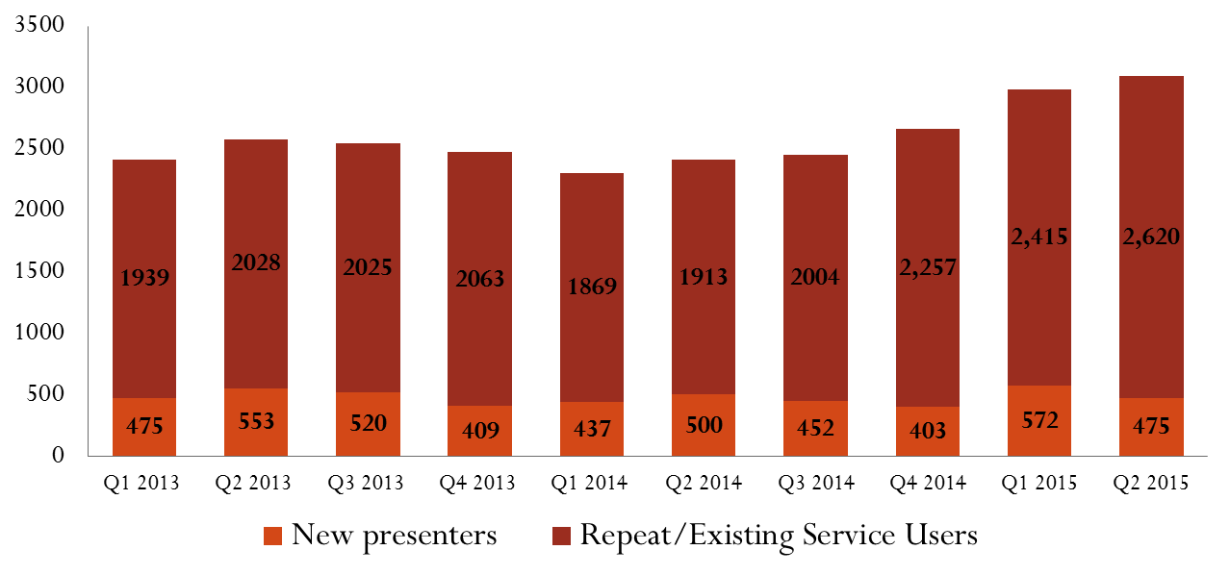
Q2 2015 Adult Individuals accessed Emergency Accommodation:3,095

Slide 9
Drug deaths in Ireland 2012
633 drug deaths
350 poisoning deaths (54% multiple drugs)
Drugs involved (Opiates 58%, Alcohol 40%, Benzo’s 39%)
Average age 40
74% male

Slide 10

Homeless drug users in Ireland
Toilets
Ambulances
07.30 daily
St Audeon’s
Community forum

Slide 11
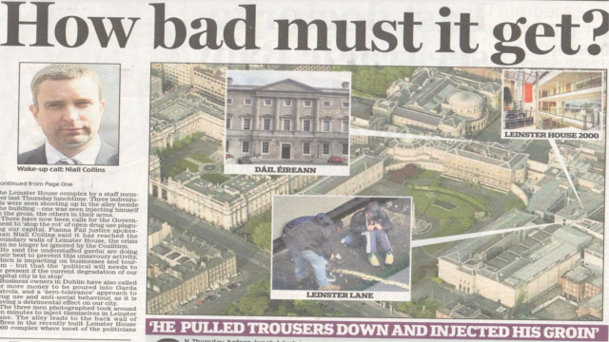

Slide 12
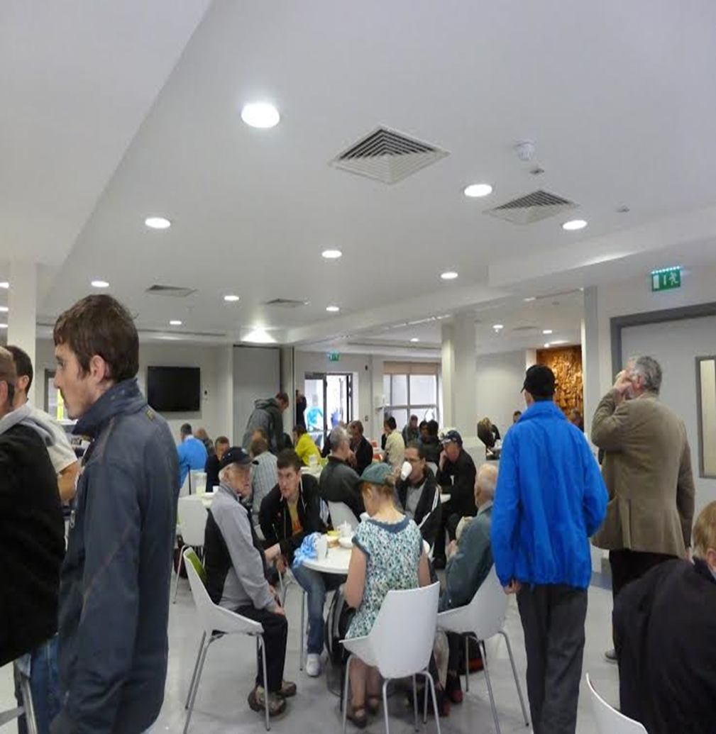
The street scene
……id seen people always buying bottles of methadone and swallowing them and they'd be a bit buzzy so I said well , I’ll be all right.....didn’t think of overdose nothing like that......(Male, 28)

Slide 13
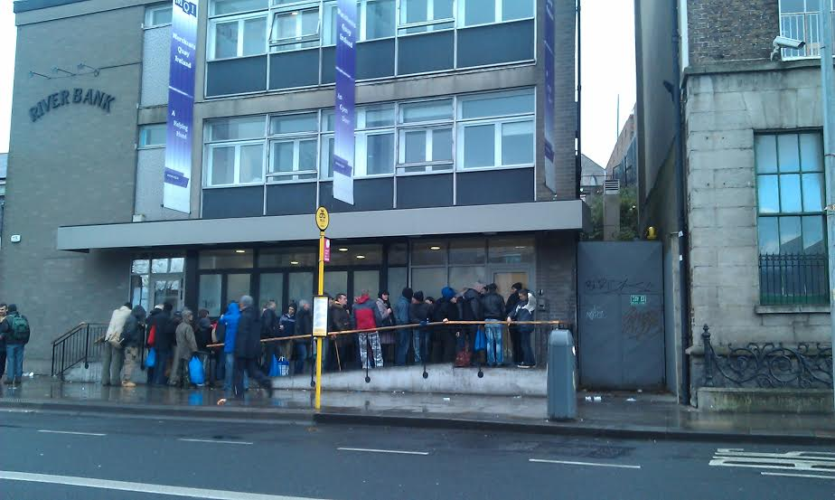
The street scene
Mistakes
The core client
Positives
Complexity
Notes:
working with drug users and FS groups around country – shout out to those from Porlaoise Group / Tullamore / Lonford / Athlone…..who helped prepare this presentation
I spoke to 10 people who were drug users…….we talked about what it was like to experience o/d
365 people affected 60 H, 113 M, 120 A

Slide 14
Integrated approaches

Slide 15
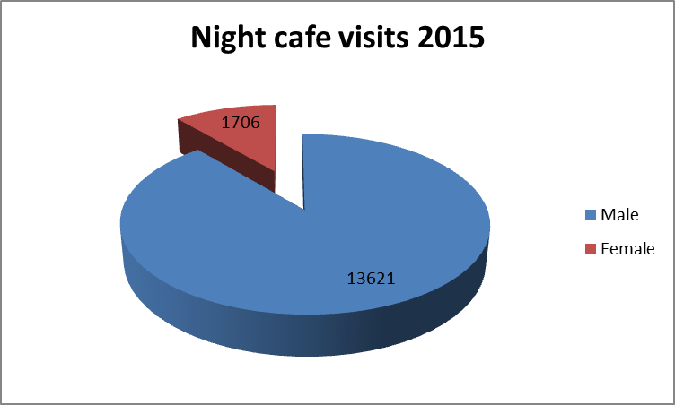

Slide 16
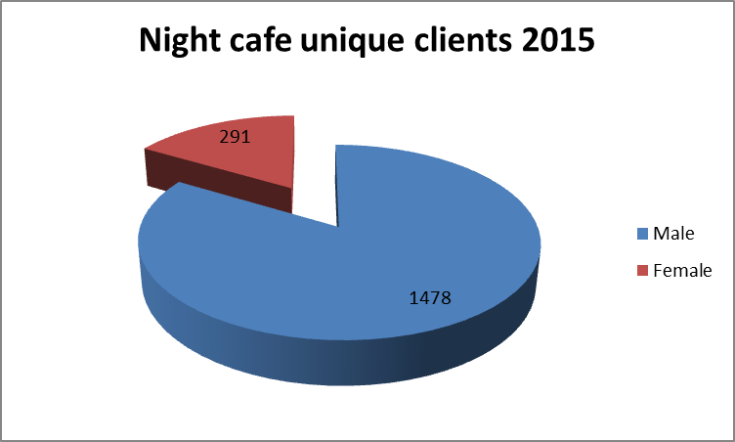

Slide 17
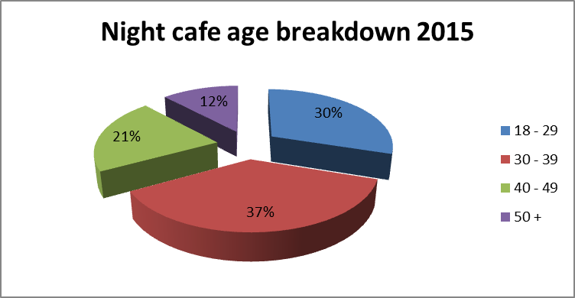

Slide 18
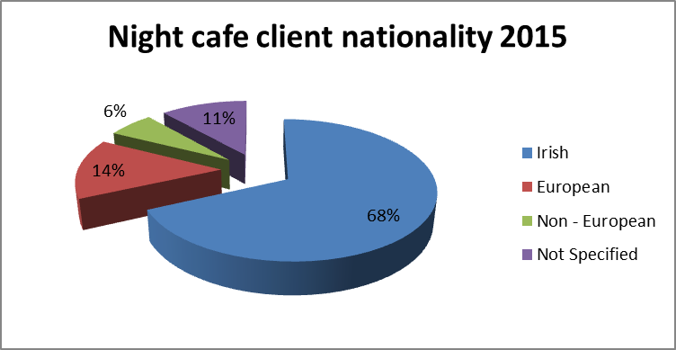

Slide 19
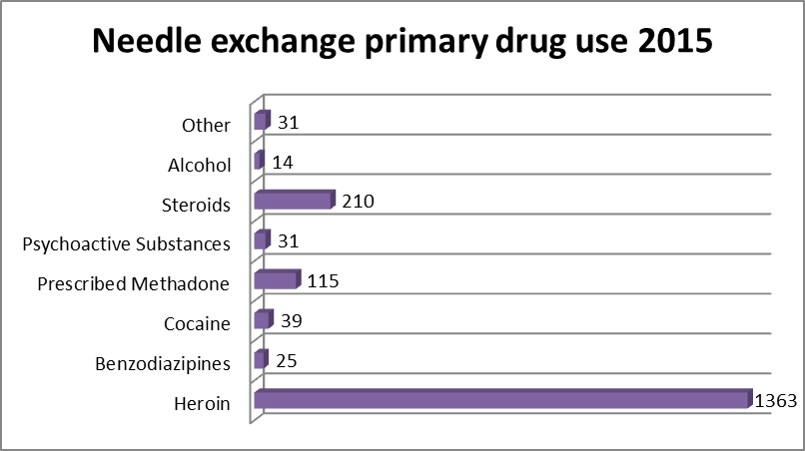

Slide 20
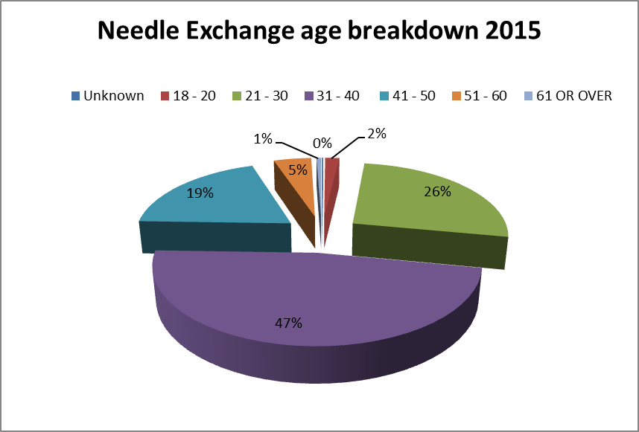

Slide 21
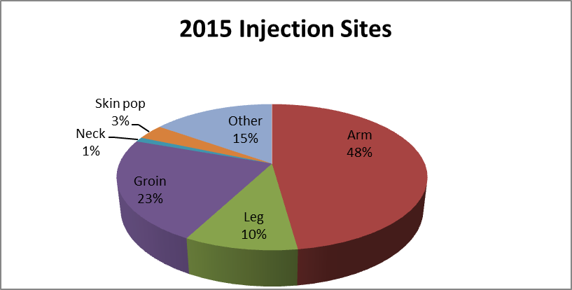

Slide 22
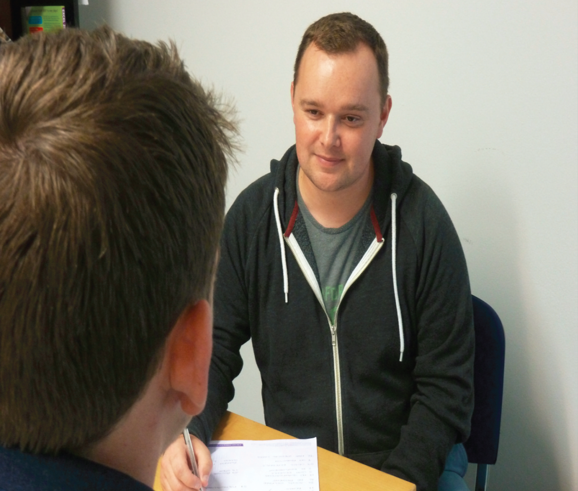
Mental health
Why
Psych nurse
Outcomes
Continuity of care
Pre-emptive action
242 individuals in 2015
Staff training
Case study

Slide 23

Housing First
MQI beneficiaries
Visiting supports
Treatment
Mental Health
Barriers

Slide 24

Going deeper
Outcomes
The 4 Tier model
Case management HUB
Youth worker (140)
Intensive outreach (214)
Case workers (34)
Psych nurse (242)
Nurse / Doc / denitst (1934)
Counsellor (250)
CRM
2 way traffic

Slide 25
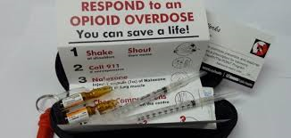
The Naloxone demonstration model
Injectable
500 trained
60 prescriptions
5 reversals
HPRA

Slide 26
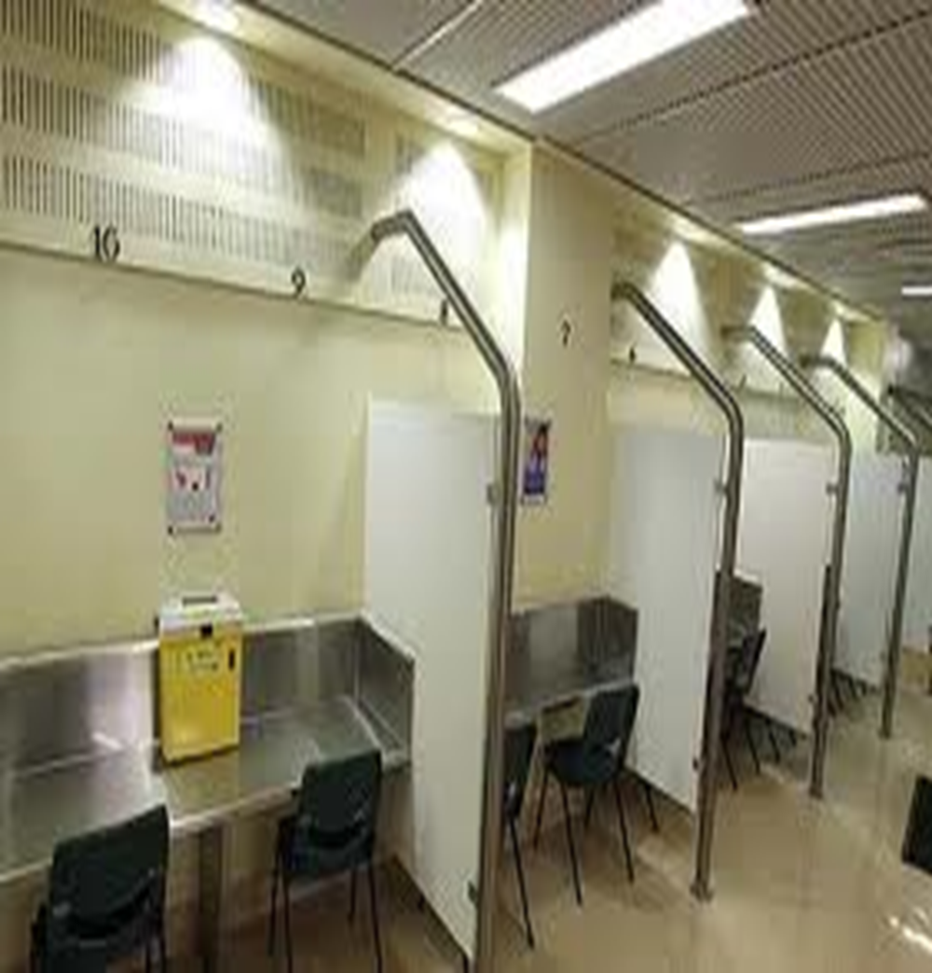
……millions of injections have been supervised and no overdose fatalities have occurred in the facilities…..... EMCDDA (2014)

Slide 27
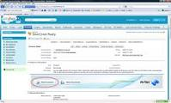
What gets results for MQI clients
Multidiciplinary approach
Inter-agency working
Having our house in order
Focusing on our core client

Slide 28
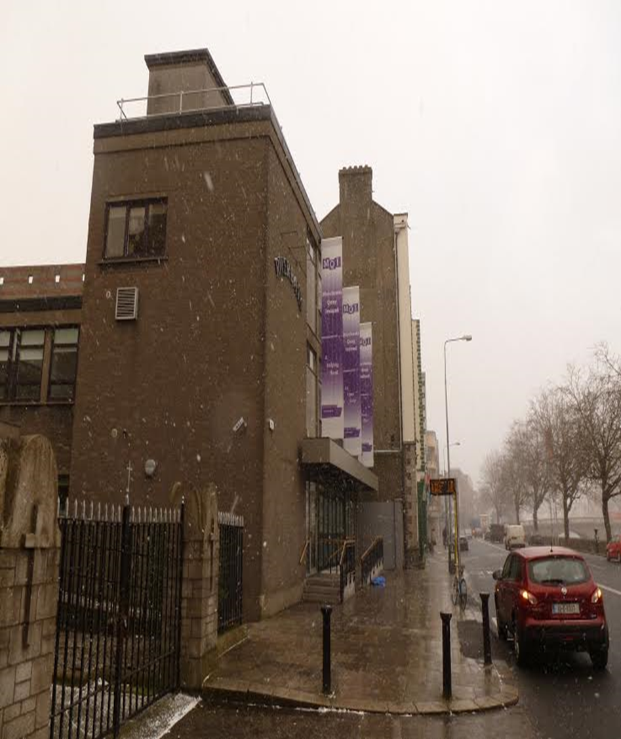
Take Home
Integrated responses
Street scene
Life saving initiatives

