Slide 1
International drugs policy and the “War on Drugs”- the impact on communities in Colombia.
José Antonio Gutiérrez Danton

Slide 2
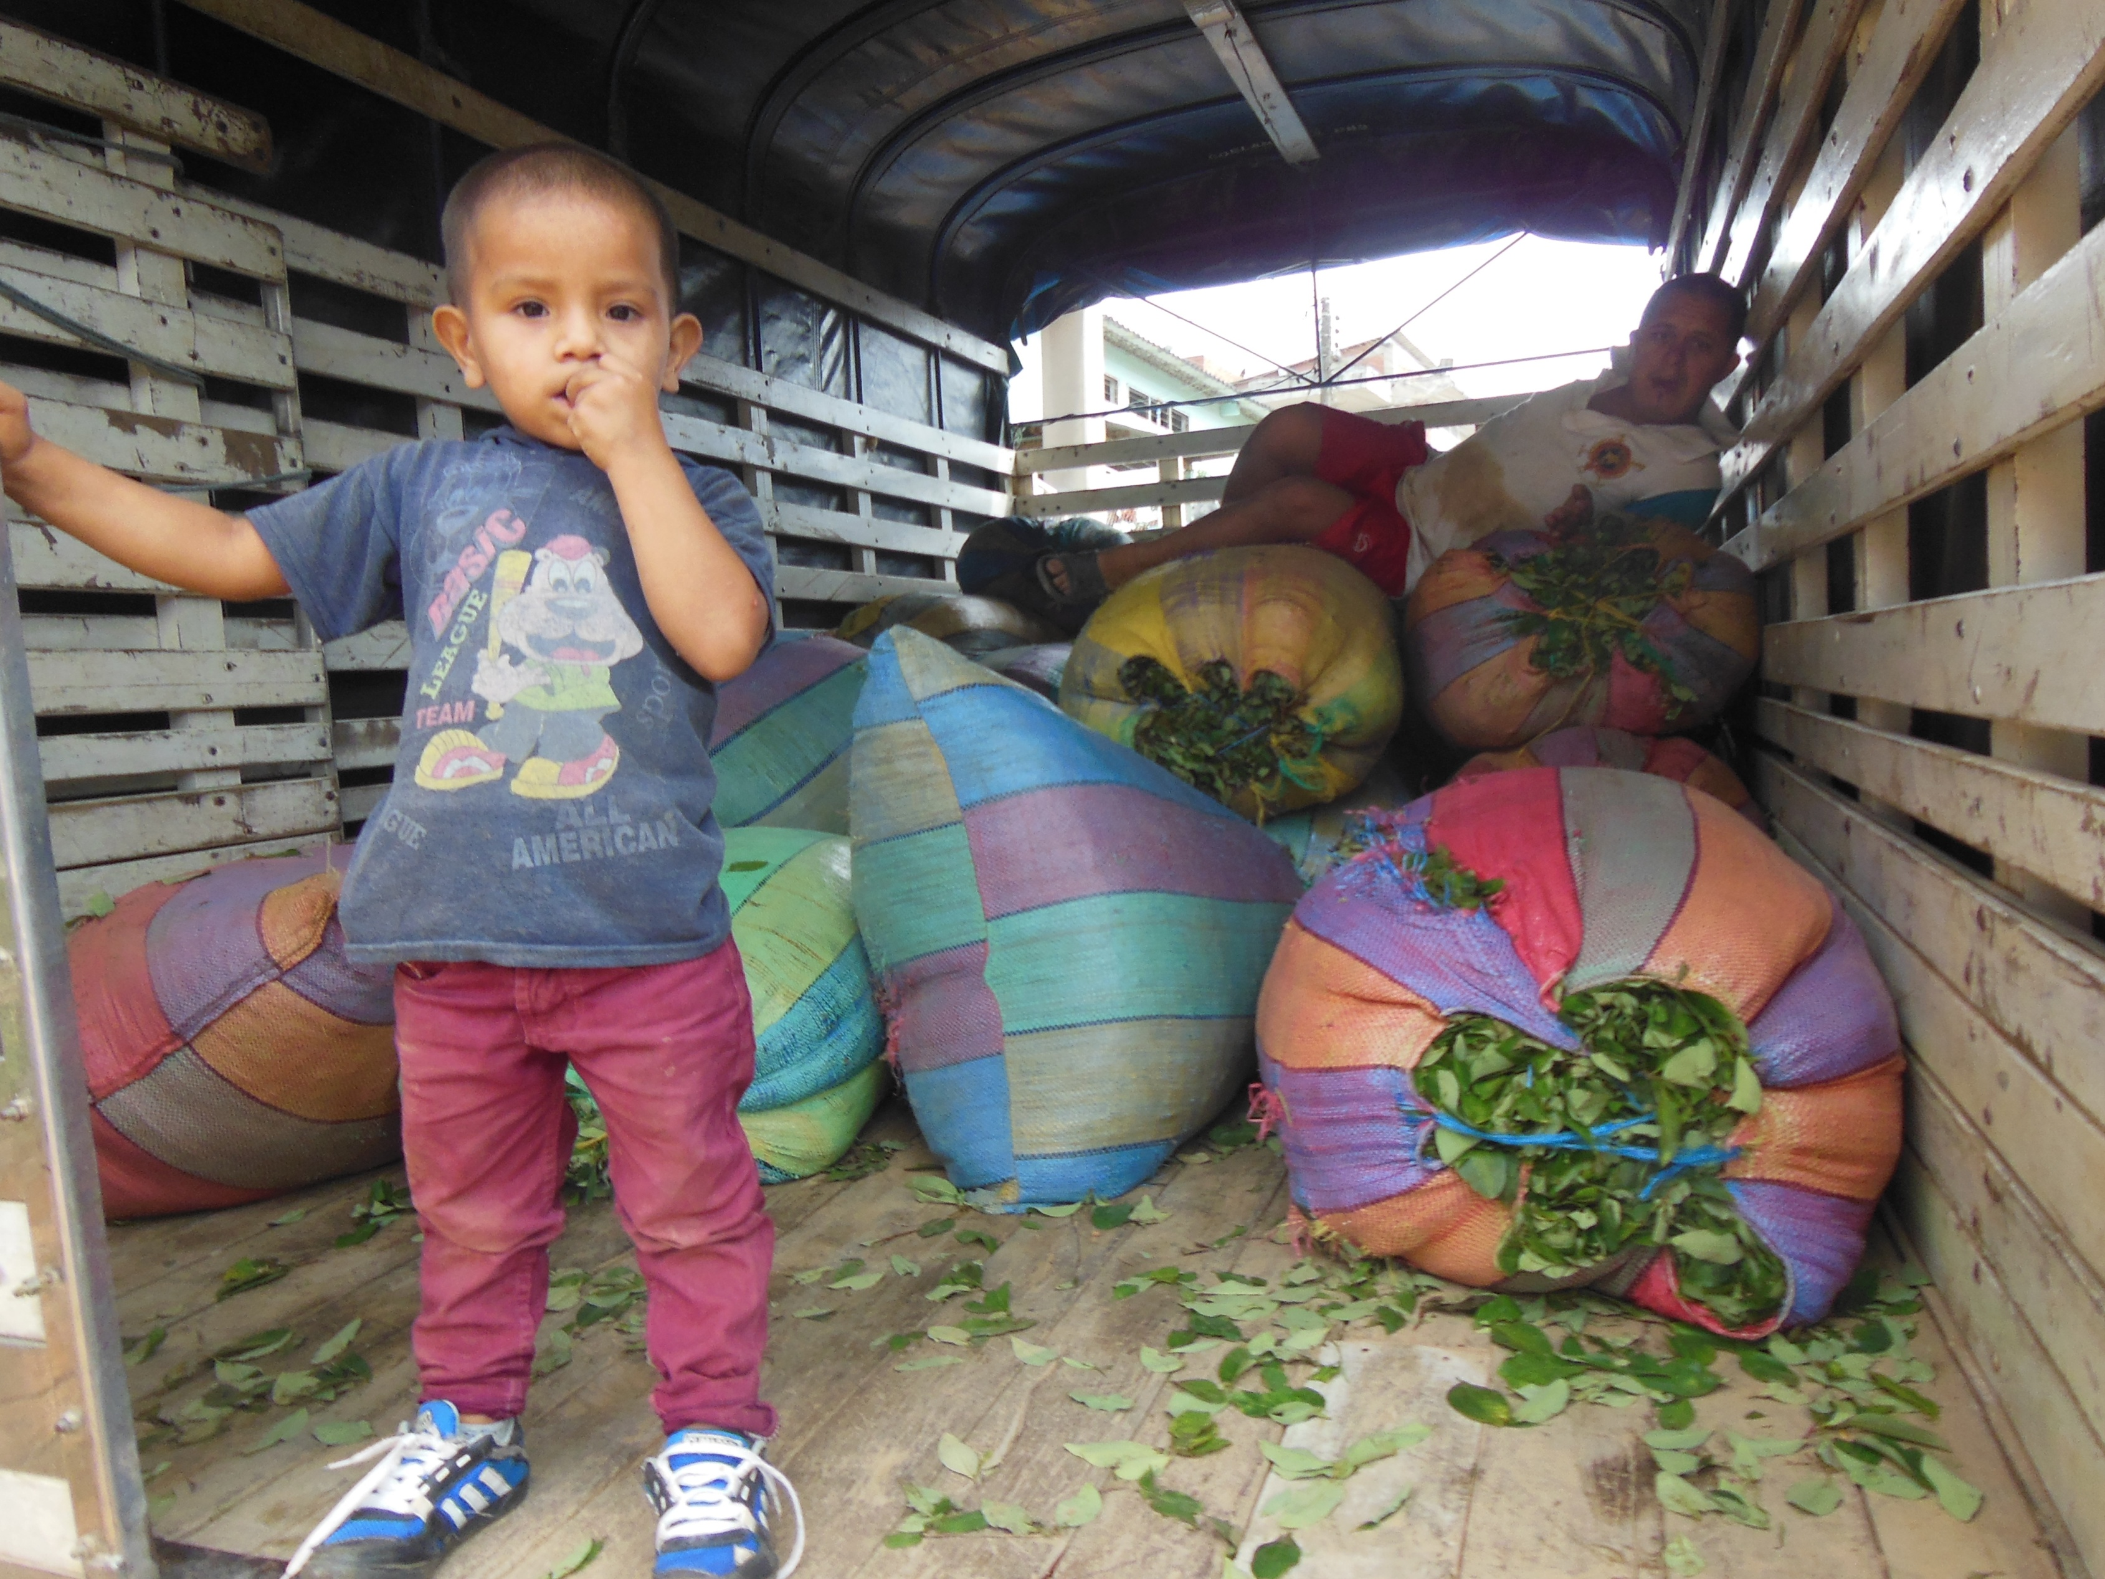

Slide 3
The War on Drugs has been fought in few countries with such devastating results as in Colombia, which served as the blueprint for the current approach to Mexico.
In both cases, the results will be long-lasting and have proved harmful at all levels, while they have not addressed the problem of drugs production or consumption

Slide 4
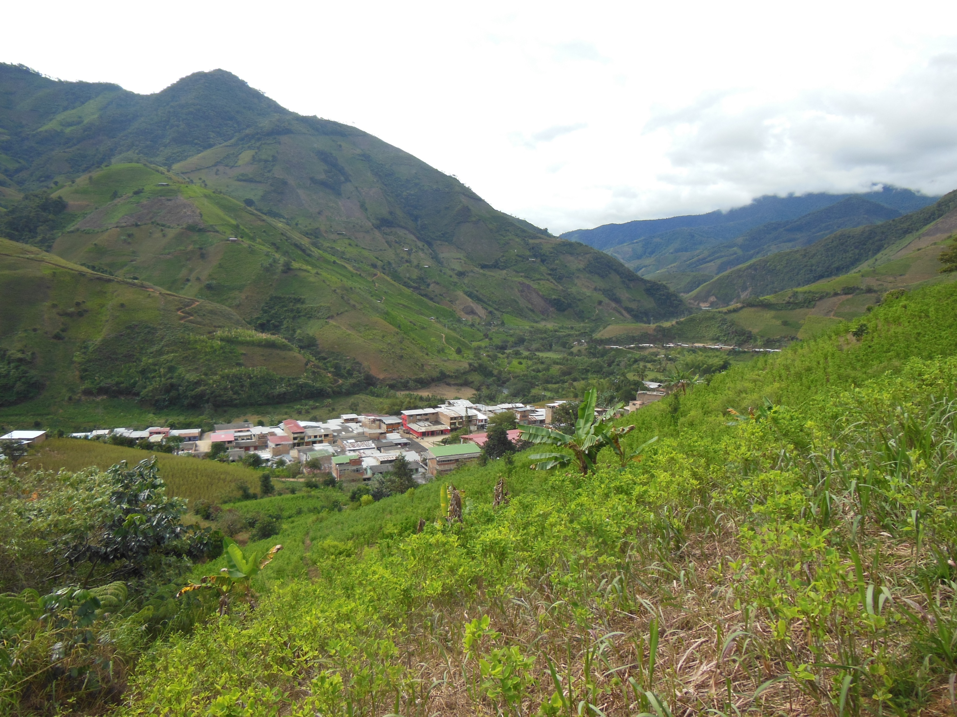

Slide 5
The burden of this policy is largely on the shoulders of the poorest of the poor: the small peasant-farmers who produce it and the urban poor who transport it out the country as mules.

Slide 6
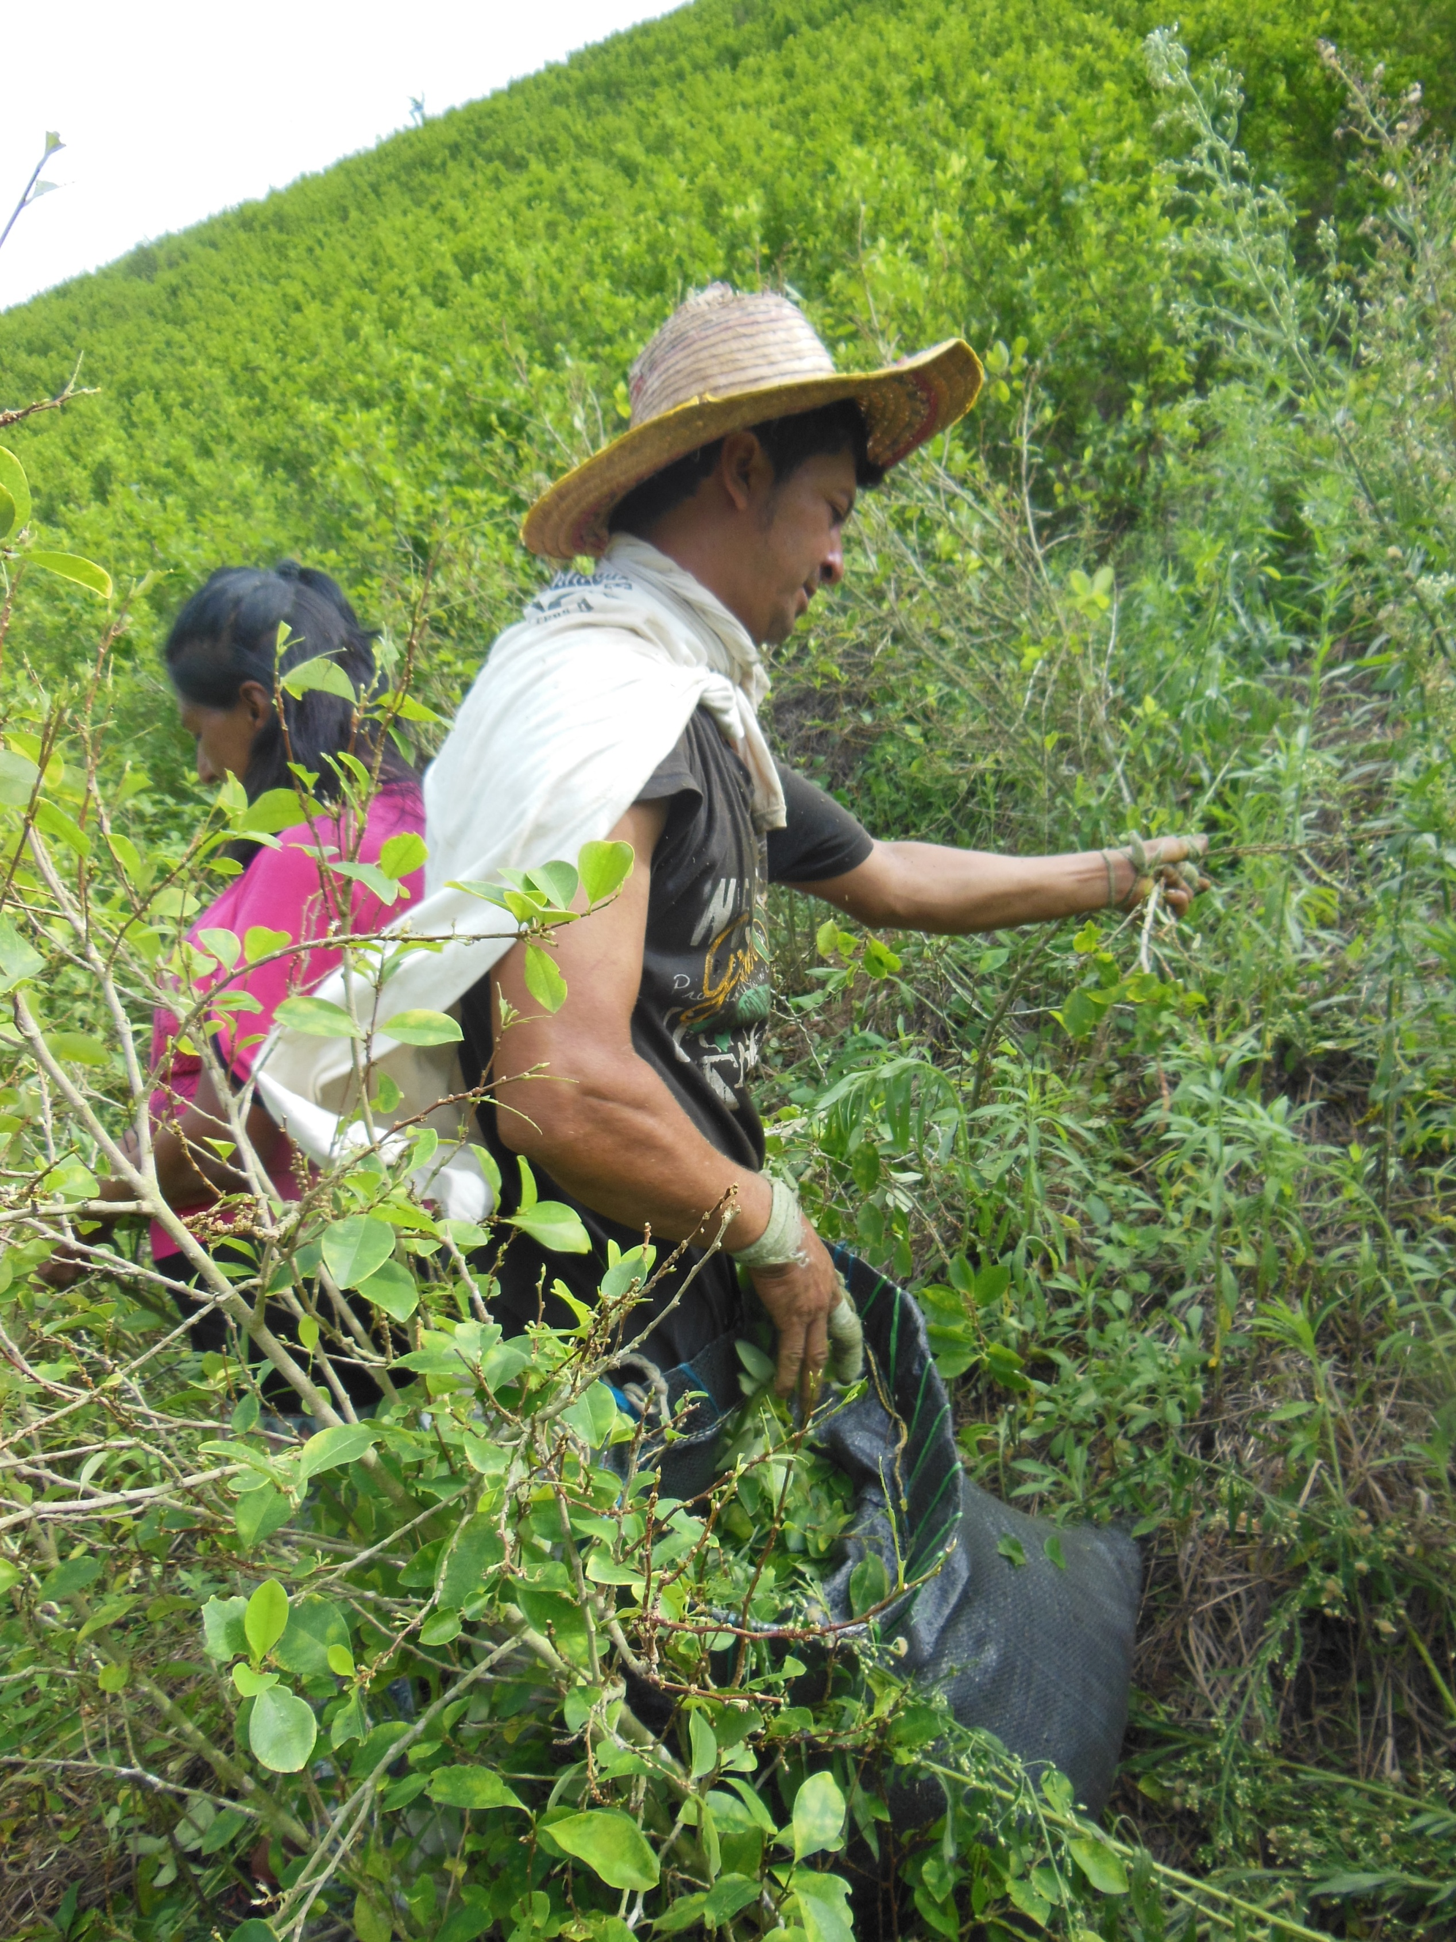

Slide 7
While the repressive policies have failed to stop the drug industry, they have made it far more profitable by increasing the risk associate to the activity.
But while the risk is absorbed largely at the lowest levels of the production chain (peasant producers and "mules"), the financial tentacles and the mafia big bosses, who make the profits are largely untouched by it, reaping the benefits without significant risks for themselves.

Slide 8
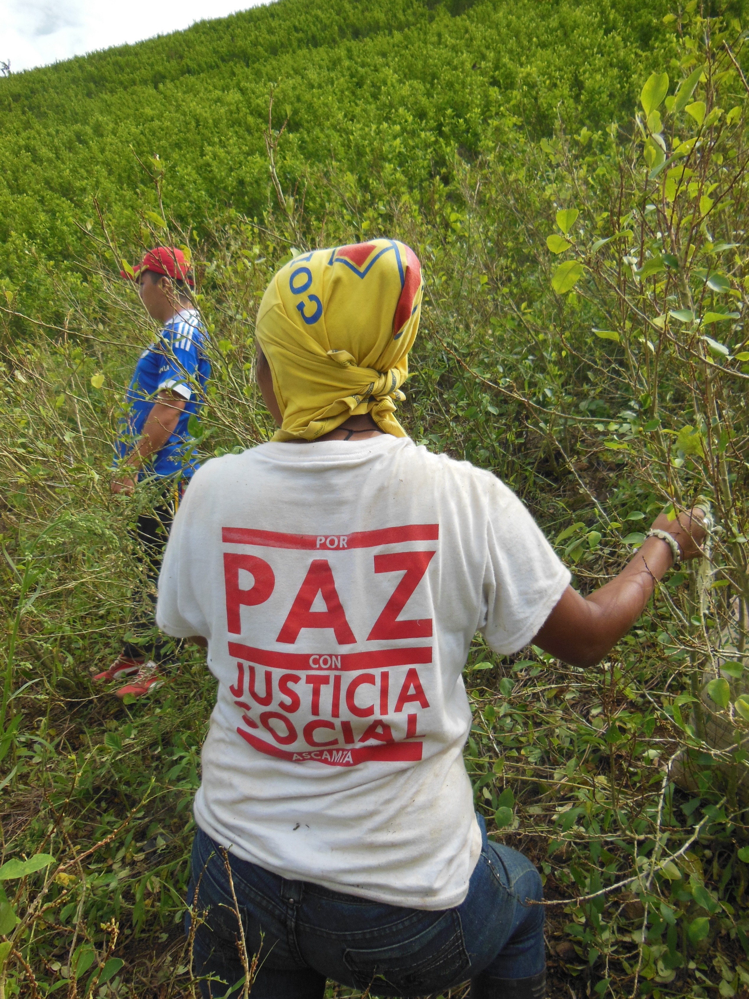

Slide 9
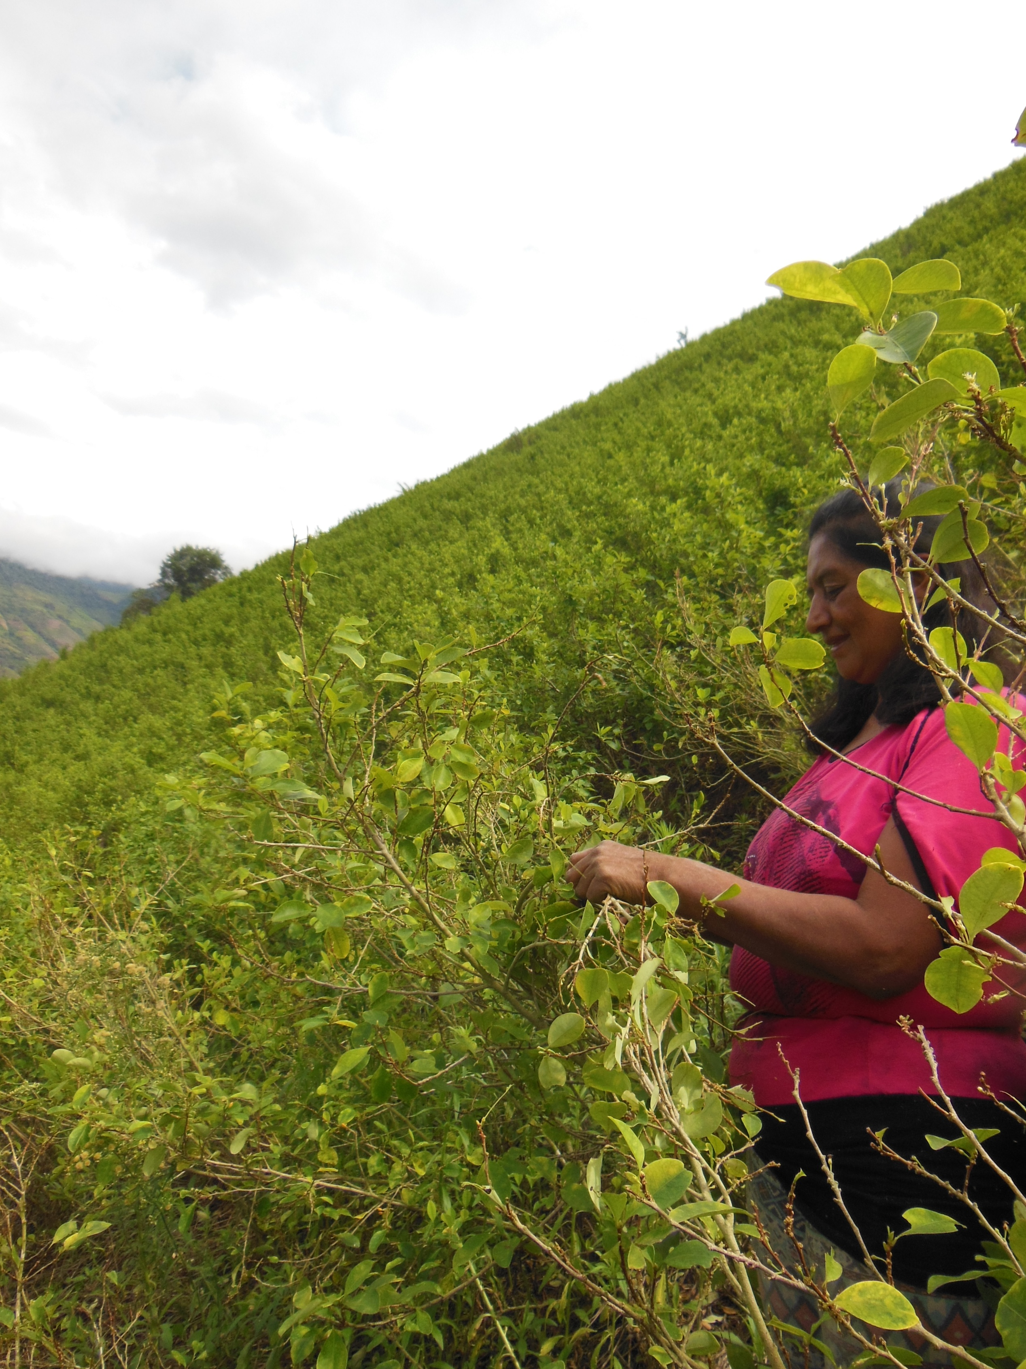

Slide 10
This ill-conceived policy has stimulated corruption at all levels and structural distortions in rural development

Slide 11
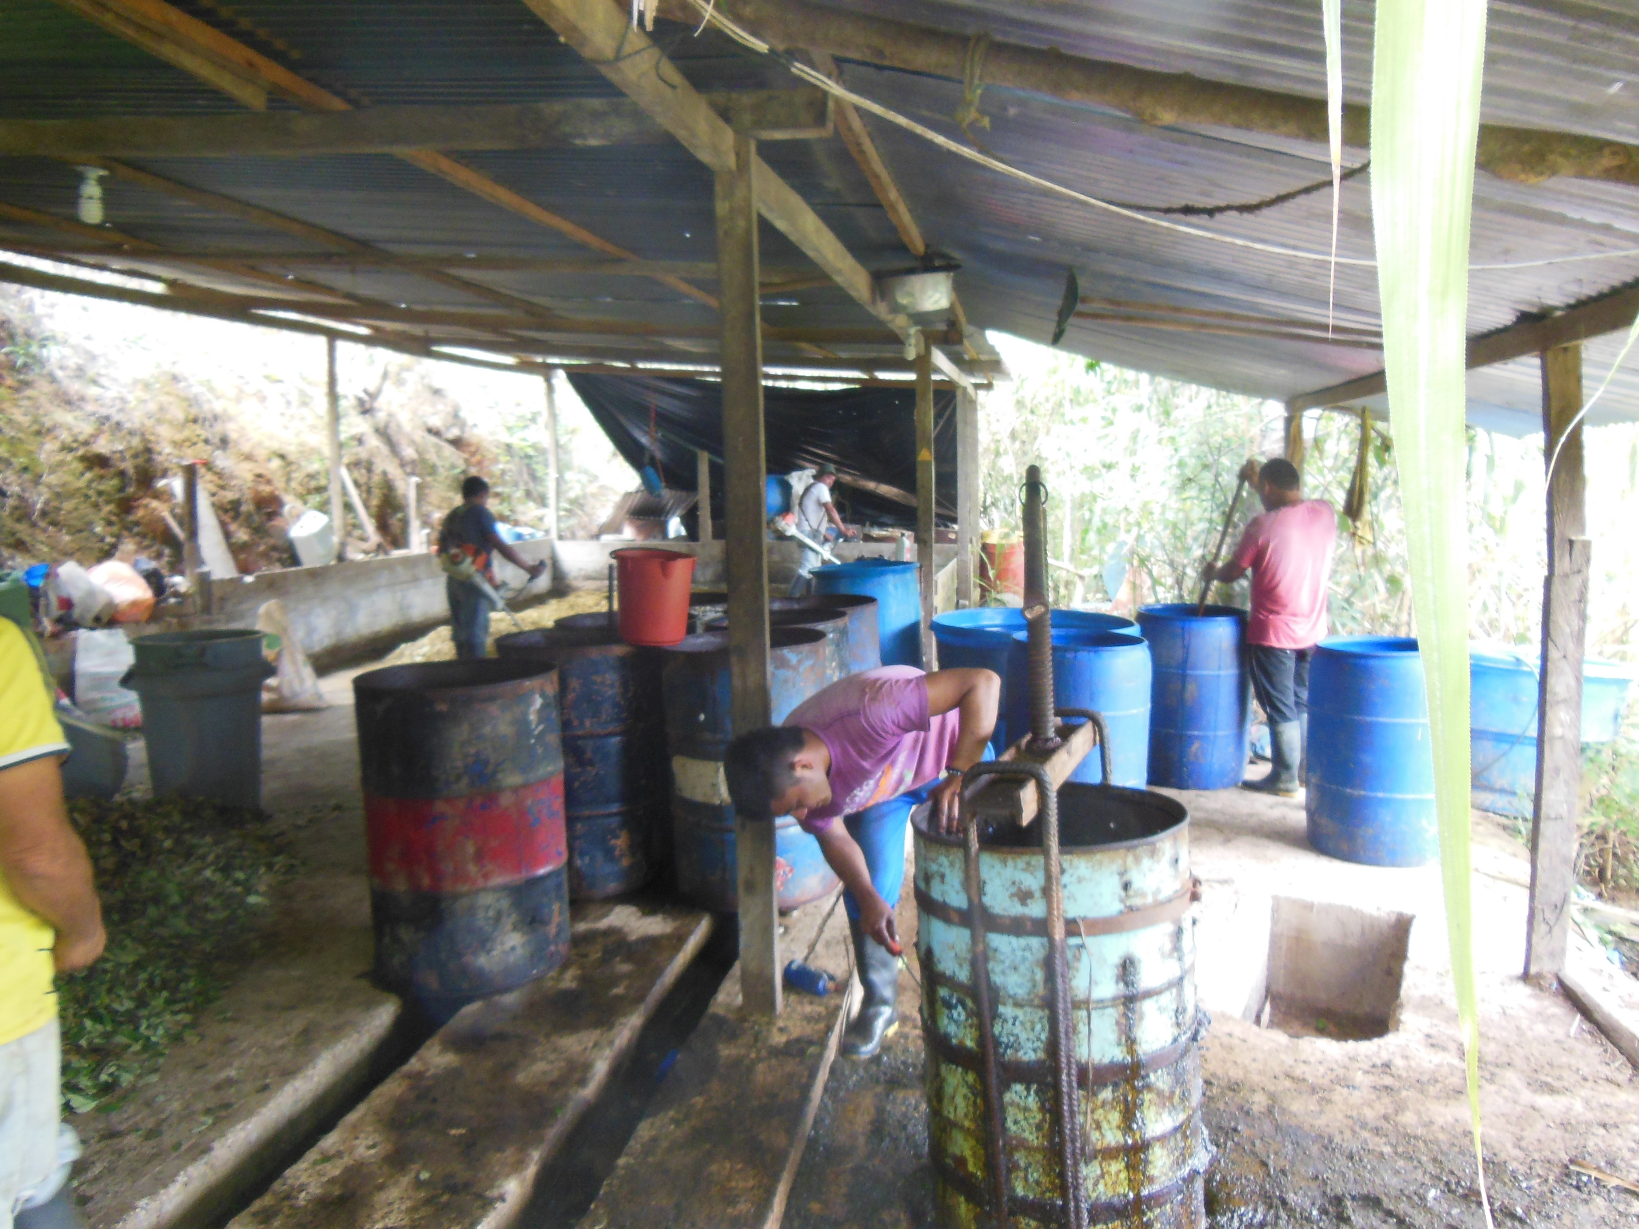

Slide 12
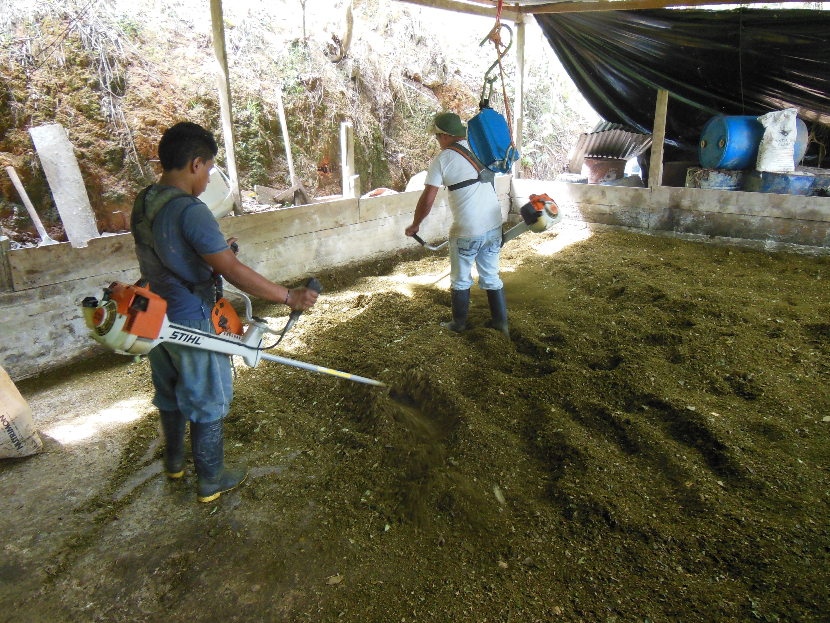

Slide 13
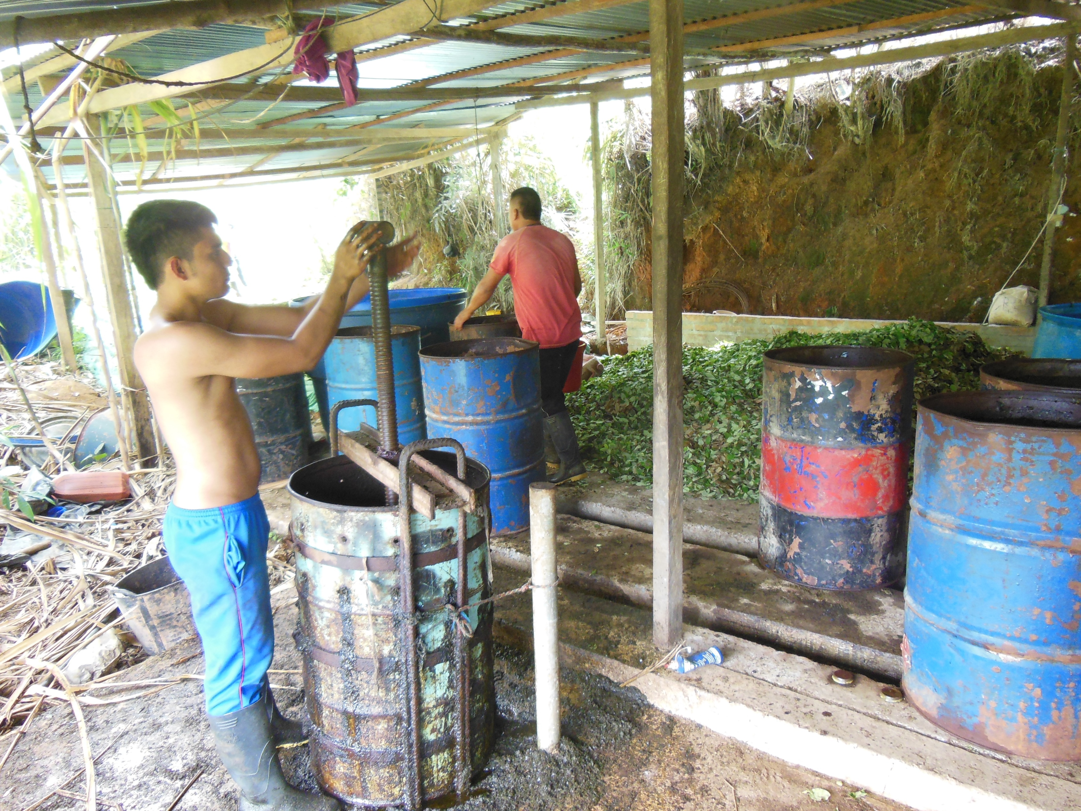

Slide 14
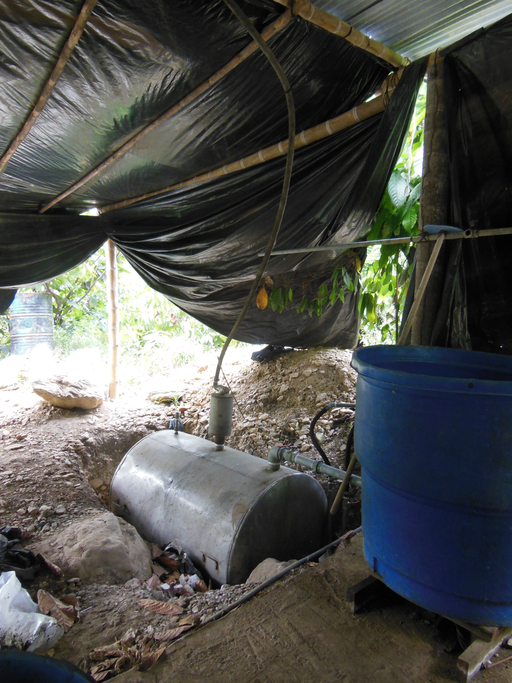

Slide 15
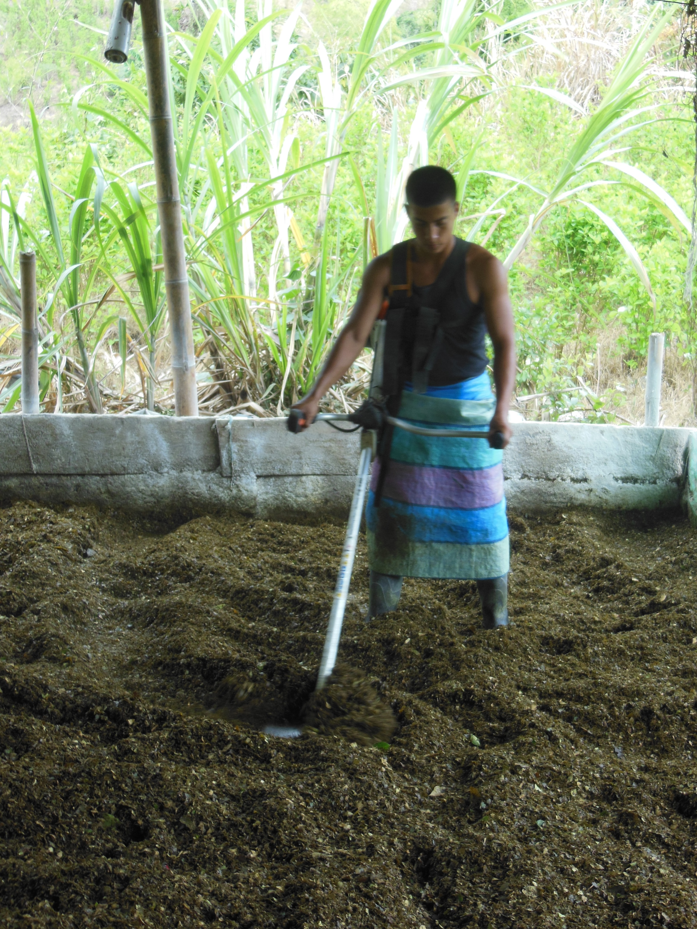

Slide 16
It is time to think beyond repressive (and failed) policies to address this problem from a constructive debate from which those communities most affected, both the poor in the North and in the South, should have a definite say

