Slide 1
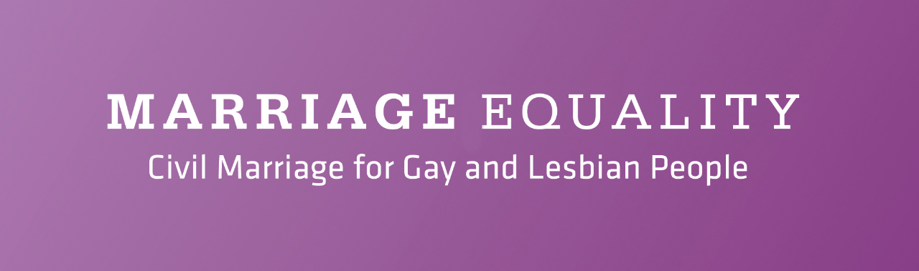
Marriage Equality
Roadmap to victory: 2008 – 2015
COMMUNICATIONS Learnings to share

Slide 2
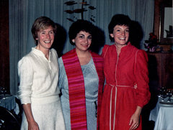
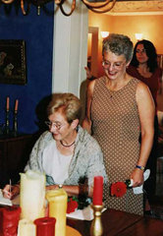
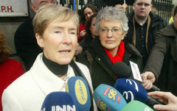
The Beginning
On 13th of September 2003 Katherine Zappone and Ann Louise Gilligan married in a civil ceremony in Vancouver, British Columbia, Canada. Their marriage is legally valid for all purposes in Canada.
They took a case against the Revenue Commissioners to have their Canadian marriage recognised in Ireland that proceeded to a full hearing in the High Court, beginning October 3, 2006.
The KAL Case The KAL Initiative Marriage Equality
  Case lost in the High Court under Ms Justice Elizabeth Dunne but succeeded in putting the issue firmly on the Irish agenda.
    Interpretation of marriage between man and woman only and children.

Slide 3
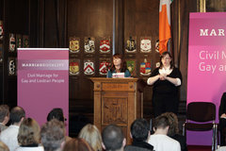
Marriage Equality is born
In 2008, Marriage Equality opens it’s door with funding from Atlantic Philanthropies;
  Two full time staff and one part time consultant
  A volunteer board
  Office space
Marriage equality initially sought through the courts with KAL and/or legislative change.
Challenges – decriminalisation 1993; some community resistance; low levels of awareness/support, “Not in my lifetime”.

Slide 4
Marriage Equality is born
Vision
  An Ireland in which same sex couples, our families and our children enjoy equality.
  To realise our vision, our mission was to achieve equal access to civil marriage for LGBT people in Ireland.
Strategy
  Legal strategy – support the Zappone and Gilligan case & raising awareness
  Communications strategy - increase visibility of the LBGT community and the rationale for equality
  Mobilisation strategy – demonstrate support from Irish Society & grass roots lobbying
  Political strategy – work with public representatives through direct contact with Staff and Board members
  Fundraising strategy – to sustain activities
Philosophy
  Sharing personal stories is key.
Notes:
Legal strategy – to raise awareness amongst lawyers about the rationale for marriage equality, the international jurisprudence and legal trends supporting marriage equality and to support the Zappone and Gilligan case for recognition of their Canadian marriage;
• Communications strategy - to increase visibility of the LBGT community and the rationale for equality through access to marriage;
• Mobilisation strategy – to ensure that there is demonstrated support for change from the public and that public representatives are made aware of this via engagement with our law makers on a grass roots level to ensure the LGBT community and the general public visit their local representatives;
• Political strategy – to work with public representatives through direct contact with Staff and Board members of Marriage Equality to ensure that marriage equality legislation is enacted.
• Fundraising strategy – to develop the organisation into a fundraising organisation to sustain activities until the goal of marriage equality is reached

Slide 5
Marriage Equality – Laying the Ground
In 2007, 56% of Irish people supported marriage equality notionally.
A conversation was required to bring the public on a journey to support
Two conversations were needed;
  The General Public
  The LGBT Community
Tone – positive & inclusive.

Slide 6
The Long Game
Think long term
Movement building
  People power, building your base.
  Coalition building, cross sectoral support.
  Political support.
  International cooperation.

Slide 7
Research and Messaging
Research crucial to understanding the landscape
  Omnibus General Public
  Focus Group LGBT Community
What percentage of people supported us, and from what sections of society?
What were the triggers/key words that would get general public & members of the LGBT community to get on board.
Research results informed the strategy and key message development.
Throughout the years we continually consulted with the community we represented.

Slide 8




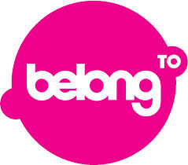




Marriage Equality – building support
Creating networks of support

Slide 9
Marriage Equality – building support
Communications
    Traditional & digital media, marketing, PR, advertising.
Communications consultant
Messaging is crucial
  Stress test messages among your community and the intended audience
  Don’t assume what you think will resonate will have impact
  Messenger as important as message
In Ireland, TV and radio advertising prohibited.

Slide 10
Marriage Equality – building support
Marriage Equality’s communications work;
  Demonstrated leadership and built trust – first port of call for media.
  Set the tone of the debate – originated symposiums, conferences, reports.
  Used messages for clear communications – proactive not reactive.
  Media trained spokespeople, LGBT couples, children of LGBT parents – shared their stories - never stopped media training.

Slide 11
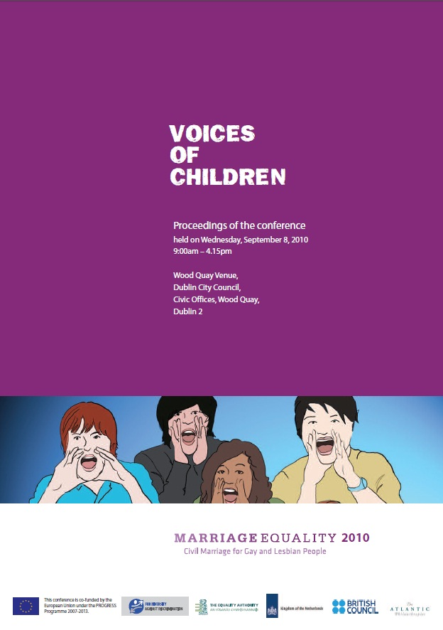
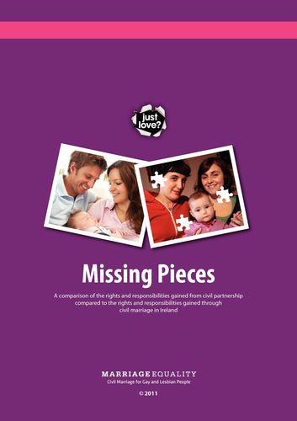
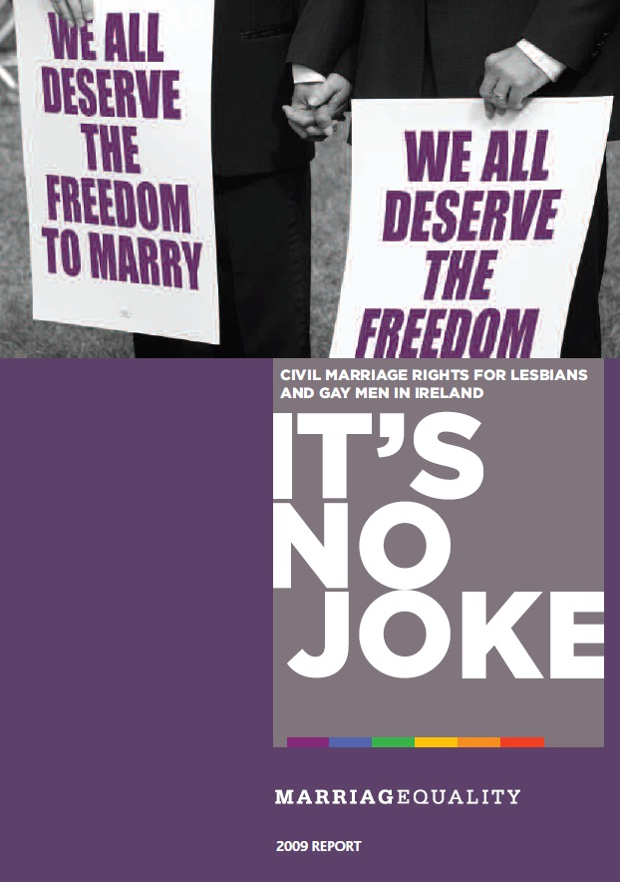
Marriage Equality – Campaign Tactics
Reports

Slide 12
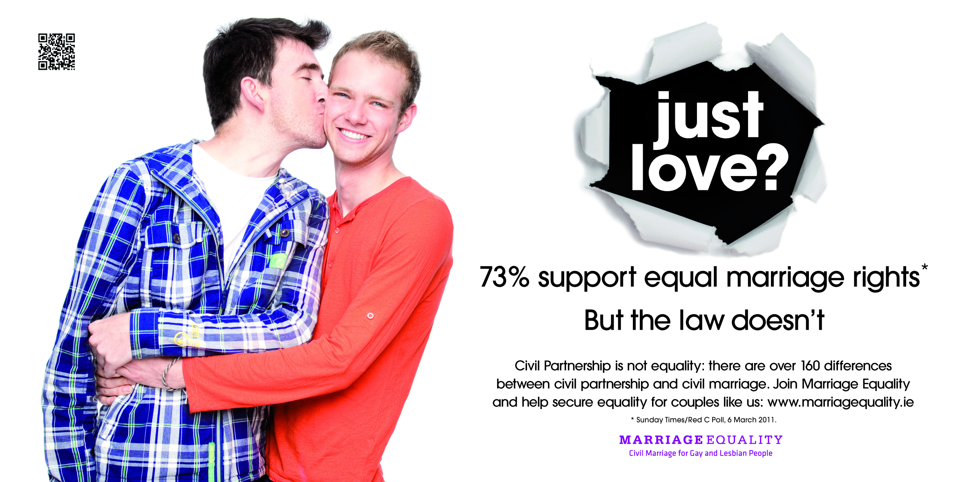
Advertising

Slide 13
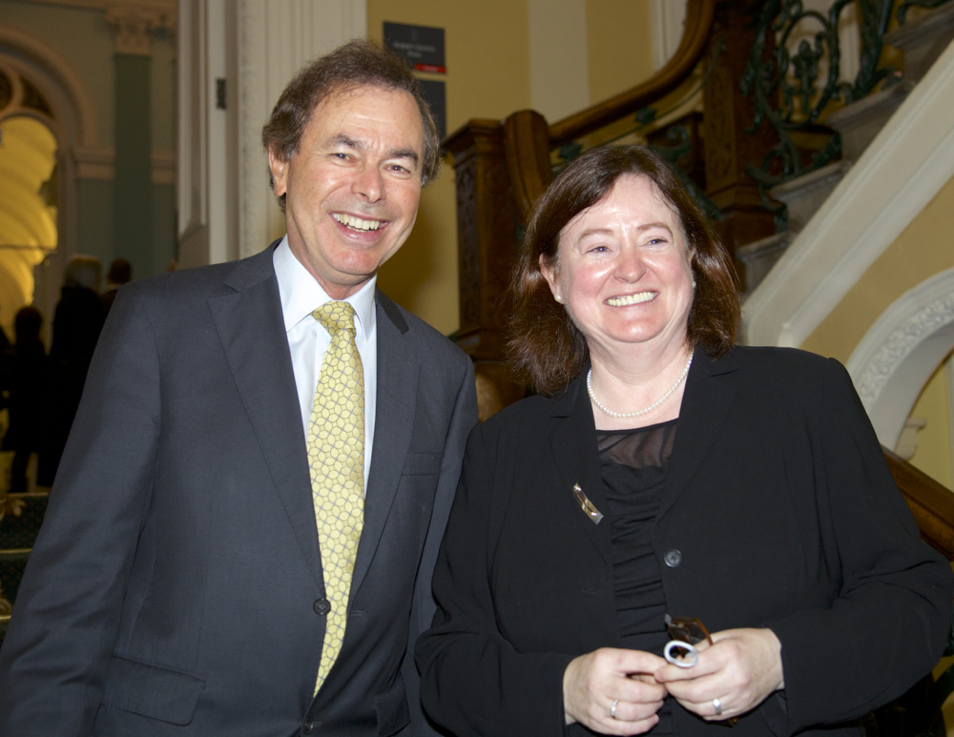
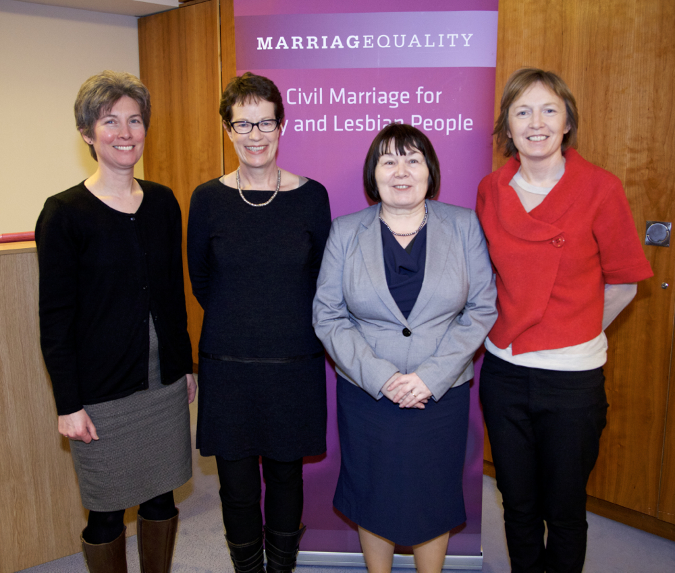
Conferences

Slide 14




Marriage Equality – Campaign Tactics
Digital Media
Notes:
stats

Slide 15
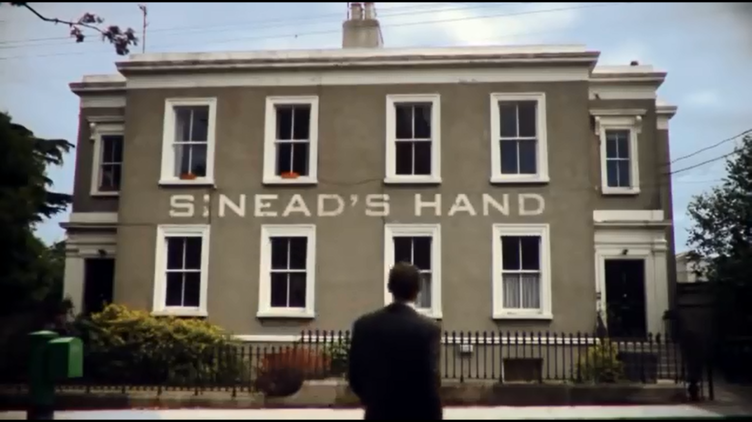
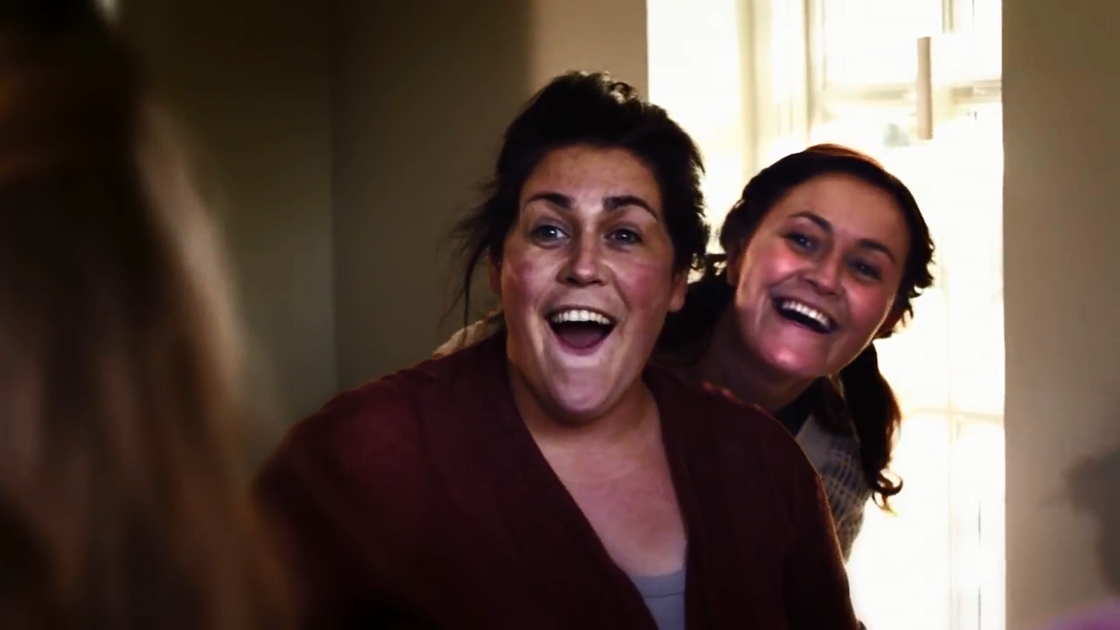
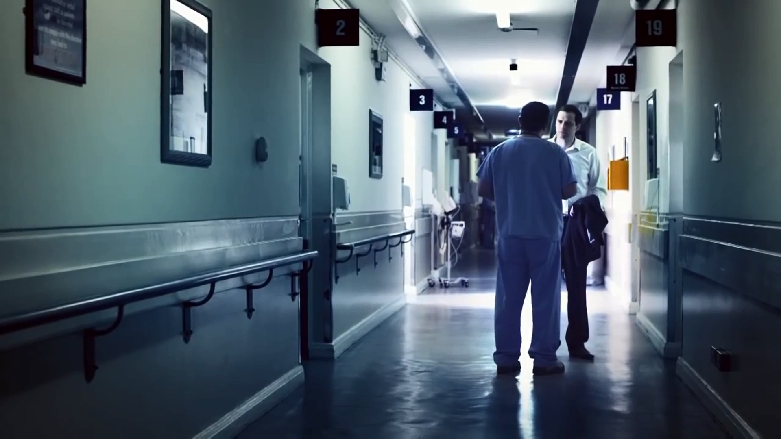
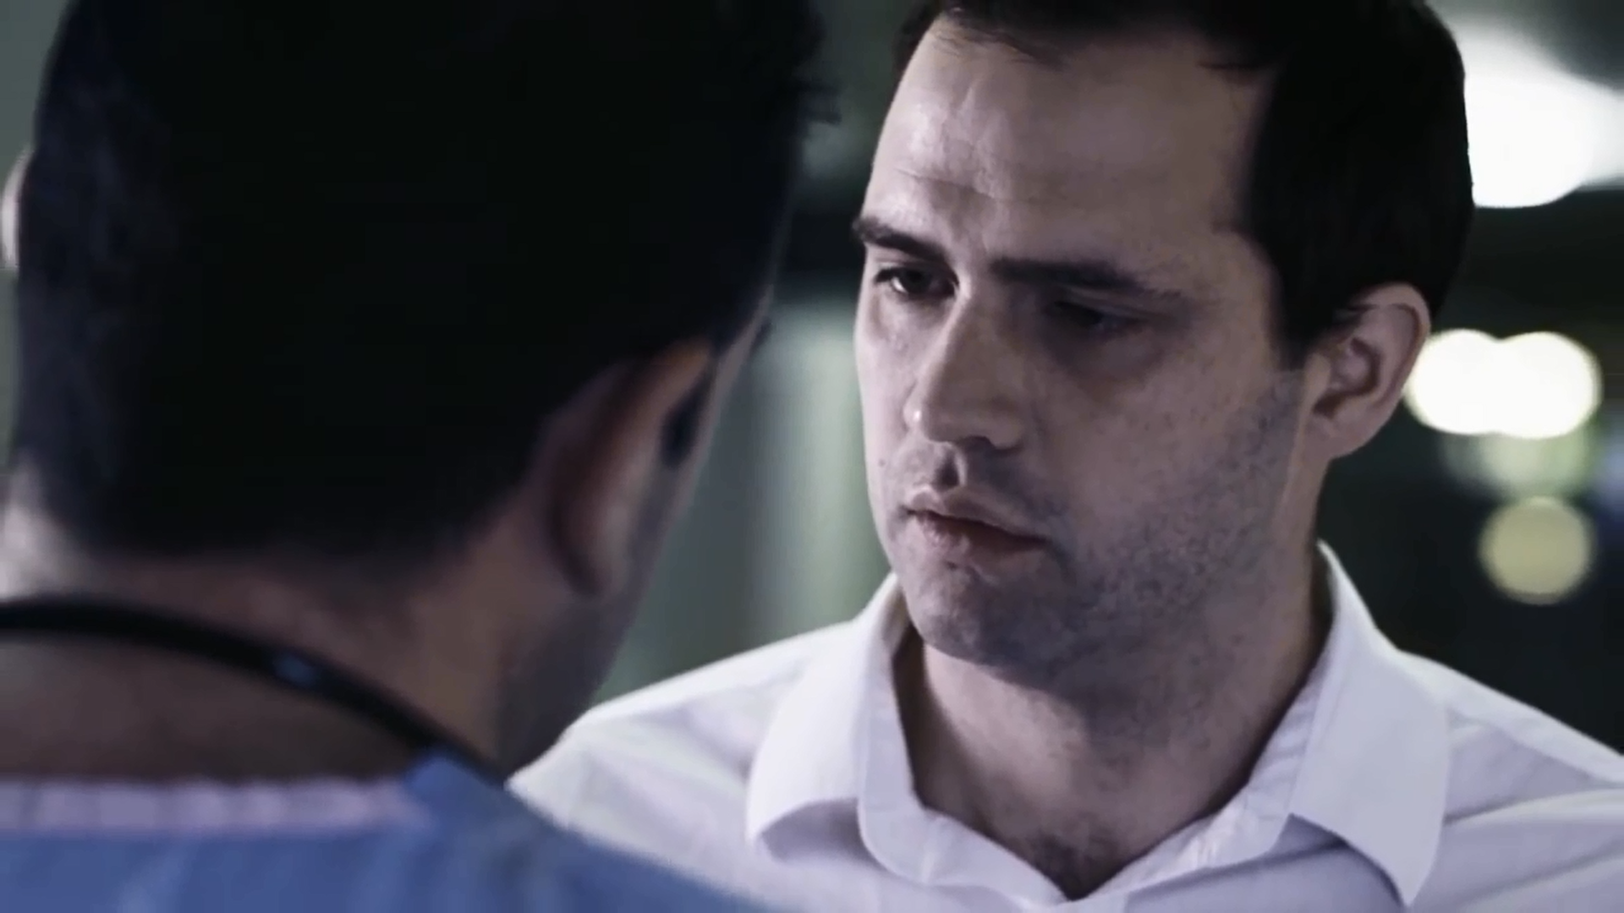
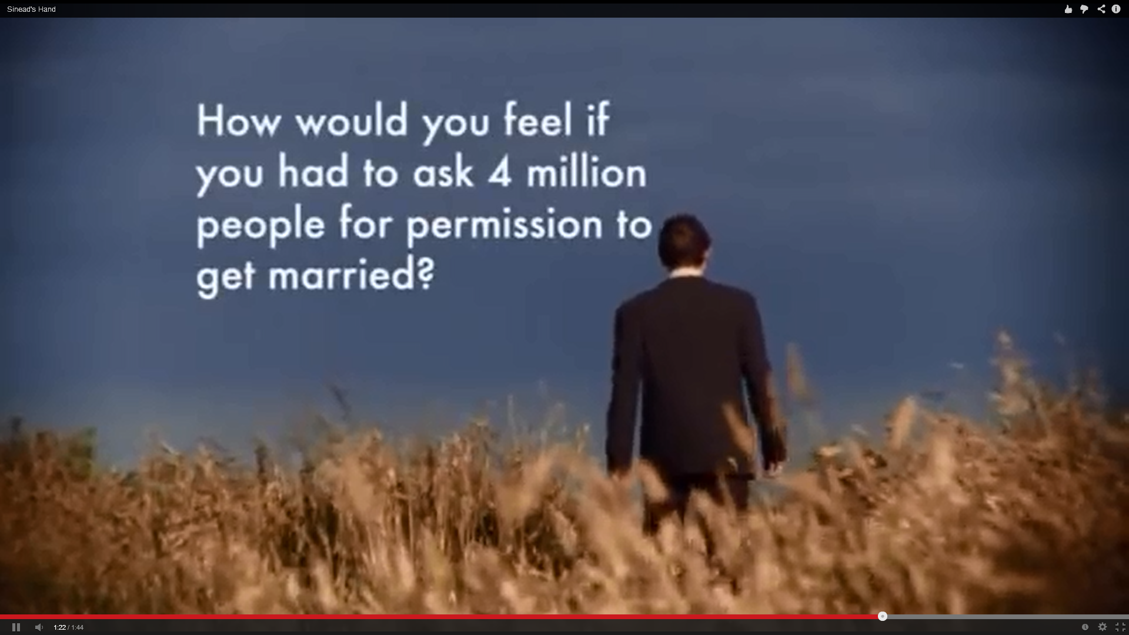
Marriage Equality – Campaign Tactics
Rory’s Story

Slide 16
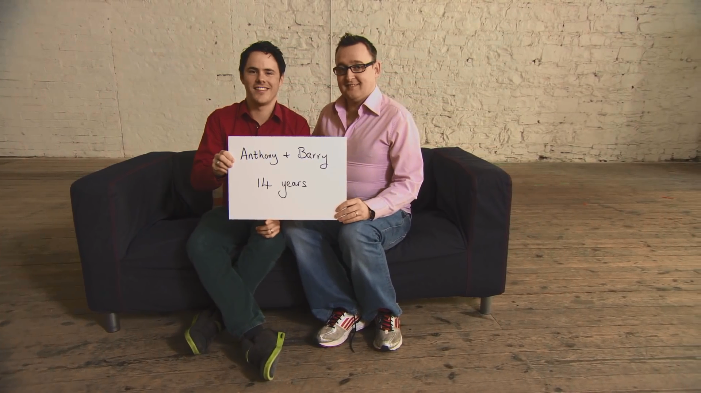
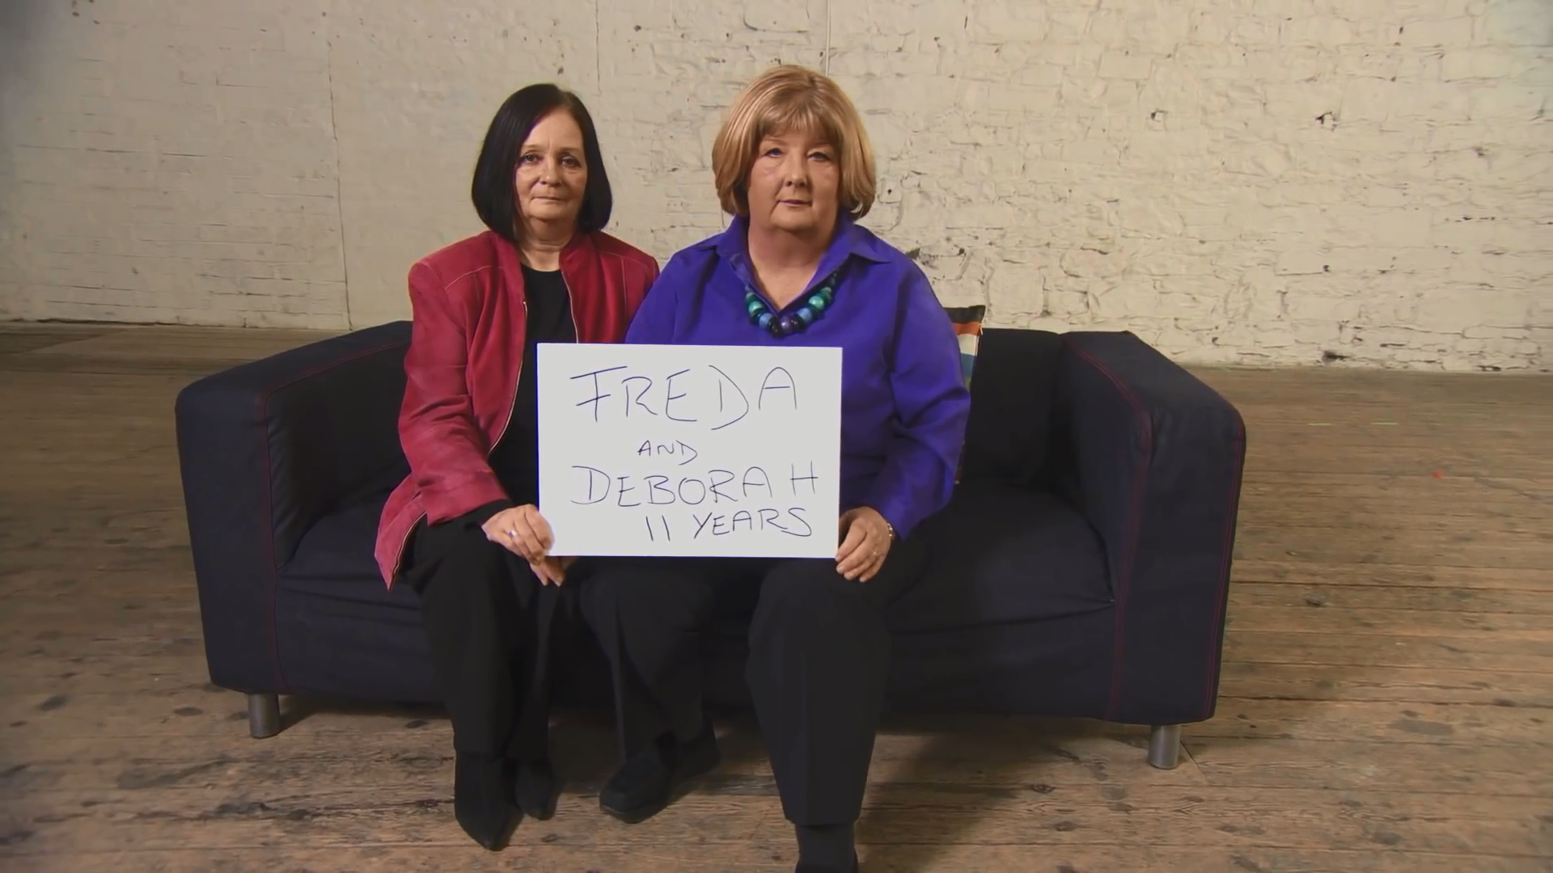
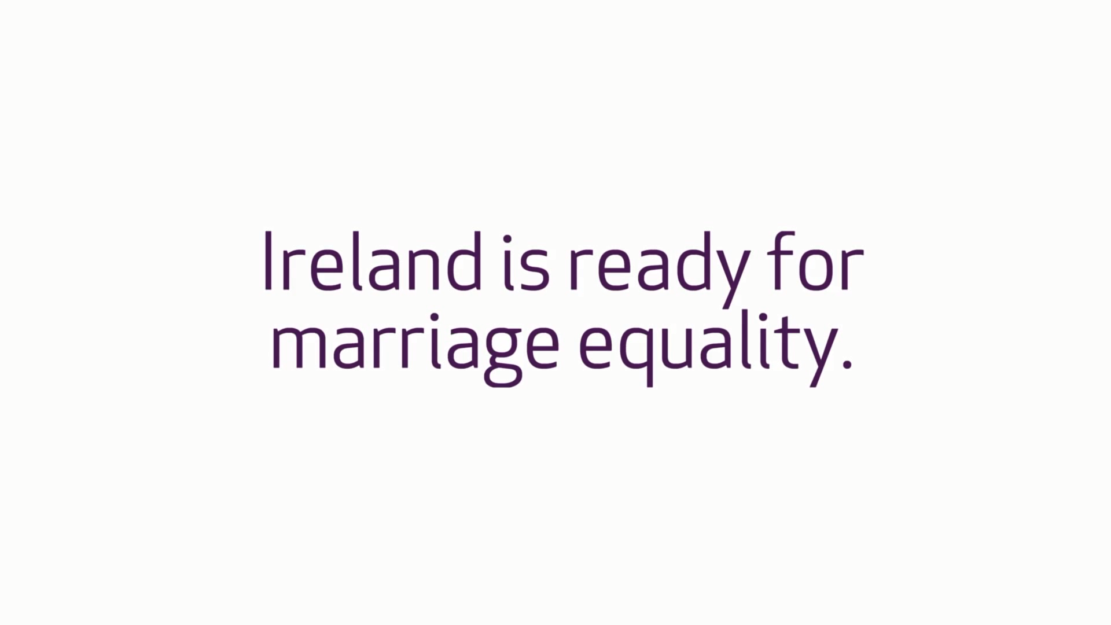

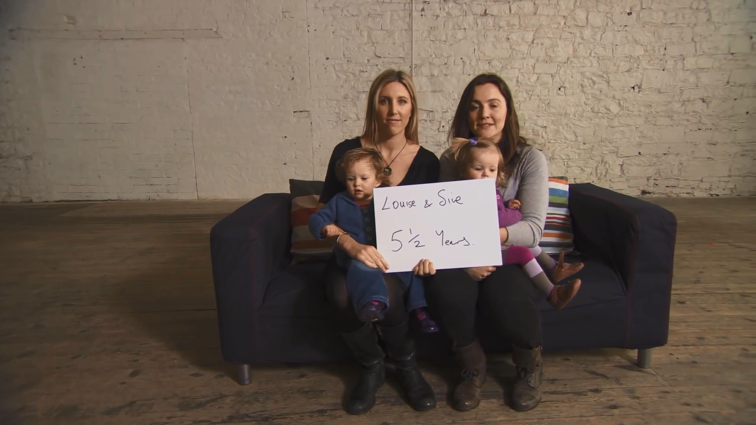
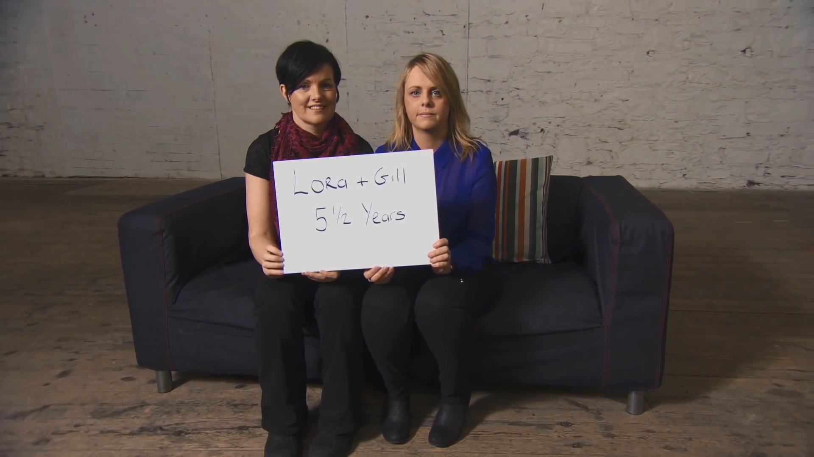

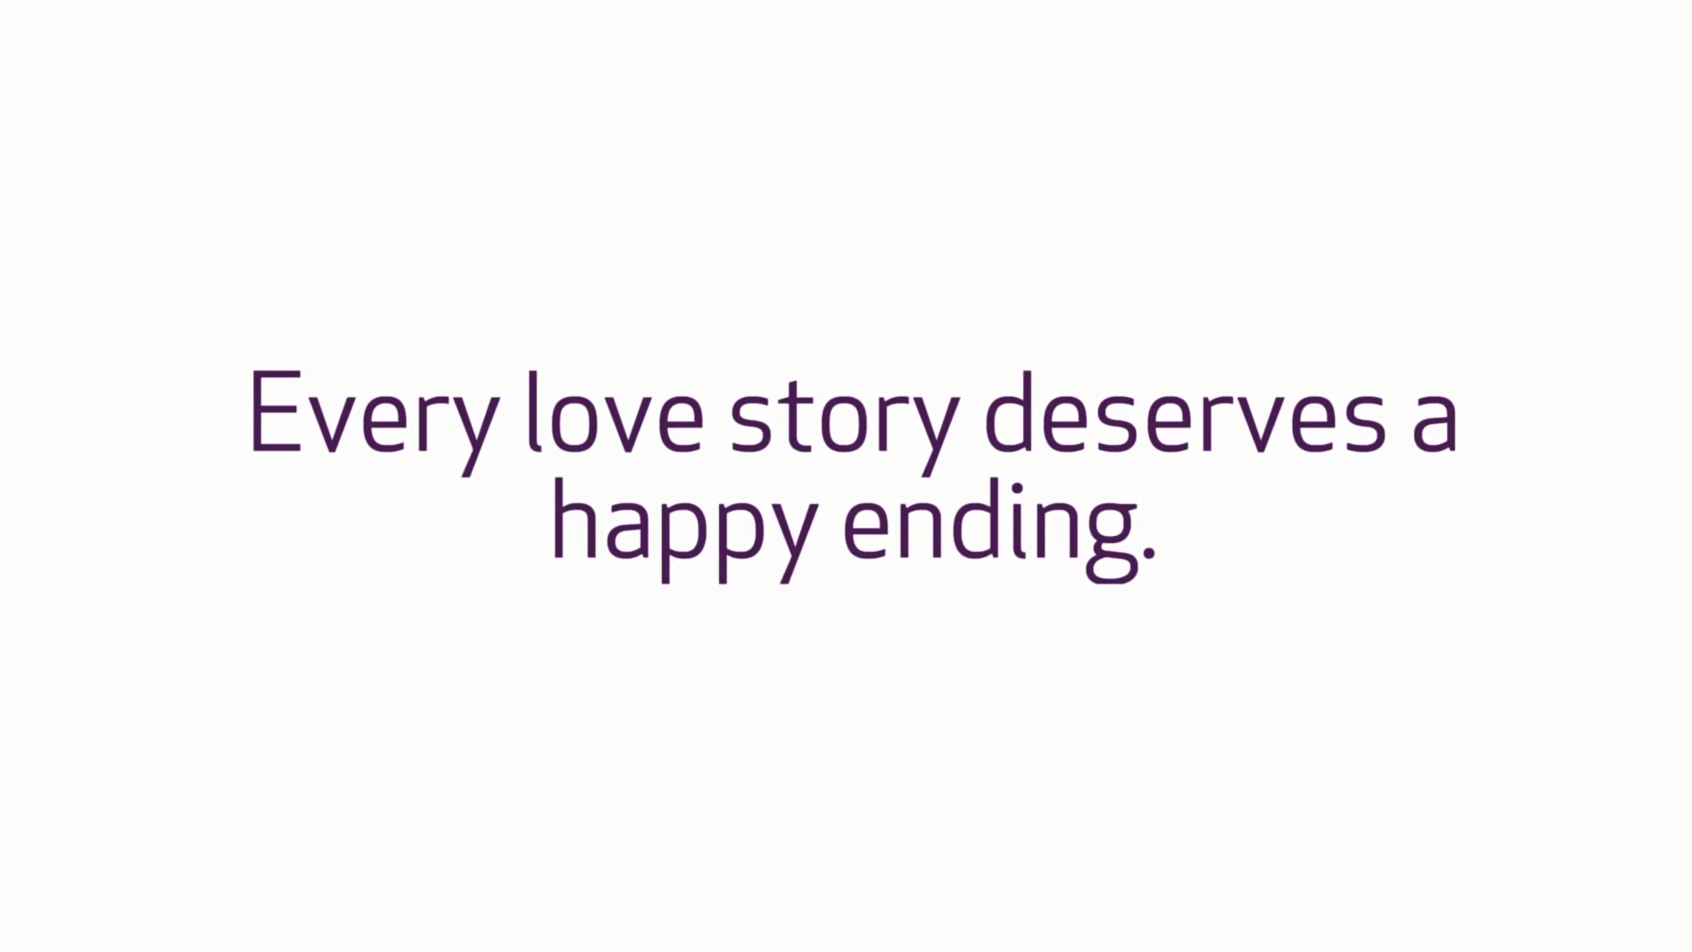
Marriage Equality – Campaign Tactics

Slide 17
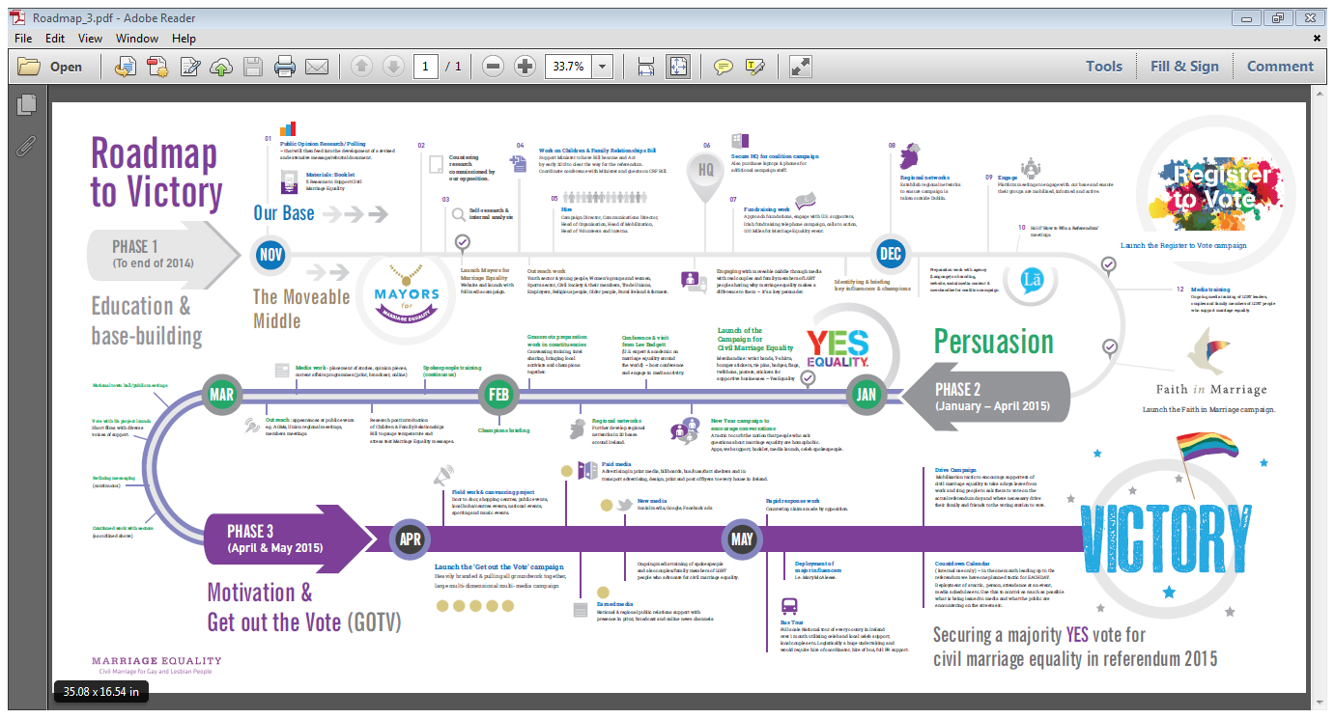
Roadmap to Victory
Insert image of Roadmap here

Slide 18
Result
Landslide 62% of the electorate said Yes.
First country to introduce marriage equality through popular vote
1,201,607 said Yes.
Historic voter turn out, highest since foundation of State.

