Slide 1
Drug-Related Intimidation and Community Violence in Drugs Task Force Areas

Slide 2
Research Origins
2011 seminar on intimidation
2012 Citywide Policy Document: committed Citywide to pursuing concrete proposals for a co-ordinate response
2013 seminar: research proposal by Johnny Connolly from Health Research Board

Slide 3
Research Aims
To access the hidden experience of drug-related intimidation nationwide
Highlight the situation to policy makers and the wider public
To assist communities in developing locally based, effective, and sustainable responses
This audit raises questions for discussion, not solutions: what are key areas that we need to investigate.

Slide 4
Process
All Local and Regional Drug Task Forces were invited to participate.
Incident report forms sent to 13 Drugs Task Forces.
Total of 140 incidents reported
Six focus groups: Travellers, Ex prisoners, Family Support, Drugs Task Force

Slide 5
Summary of key findings

Slide 6
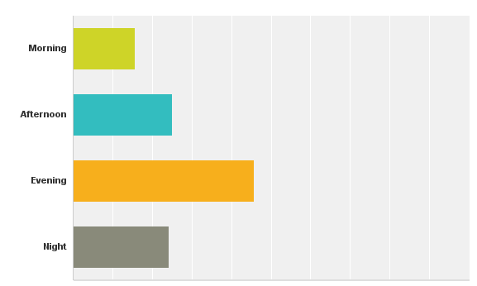
Q4 – Approximate time of day when incidents occurred:
16%
25%
46%
24%

Slide 7
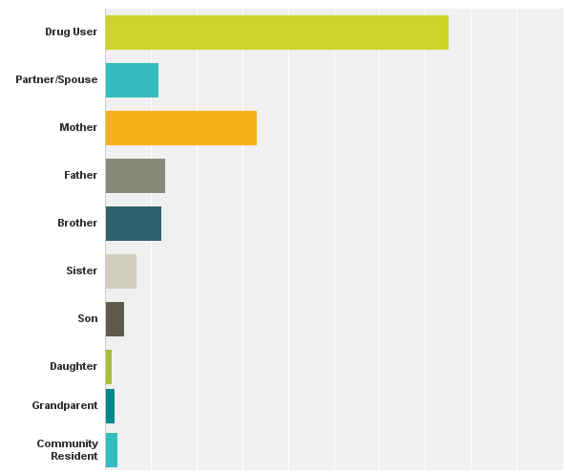
Q6: Who is the intimidation or violence directed at?
75%
12%
33%
13%
12%
7%
4%
1%
2%
3%

Slide 8
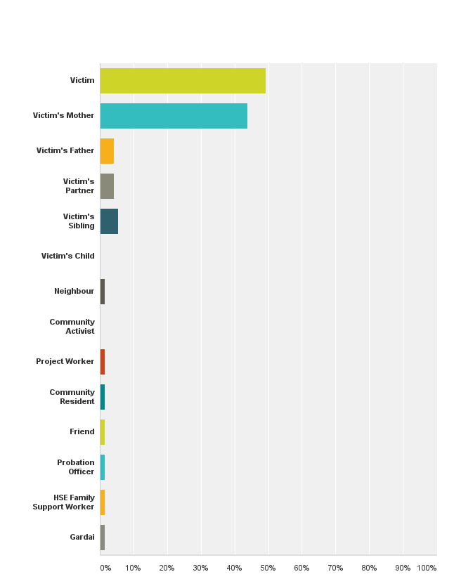
Q8 – Who reported the incidents?
50%
39%
4%
4%
5%
1%
1%
1%
1%
1%
1%
1%

Slide 9
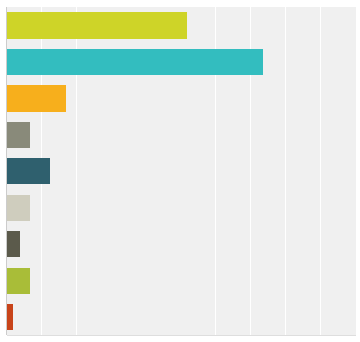
Q.9 – Reported reasons behind the intimidation or violence:
To frighten
To reclaim drug debt
To obtain money (extortion)
To reclaim illegal money lending debt
To enforce gang control
To enforce silence regarding drug dealing
To enforce silence regarding other illegal activities
To recruit into illegal activities
Reasons unknown
52%
74%
17%
7%
13%
7%
4%
7%
2%

Slide 10
Q7. Nature of the incidents:
76%
46%
32%
6%
10%
9%
1%
1%
1%

Slide 11
Escalation from verbal to physical
Repeated incidents go on for months
A campaign of terror that causes stress and despair for families
Puts great strain on project workers who are doing a difficult job with lack of resources
Coercion and entrapment: assisting dealers activities, storing and delivering drugs and weapons

Slide 12
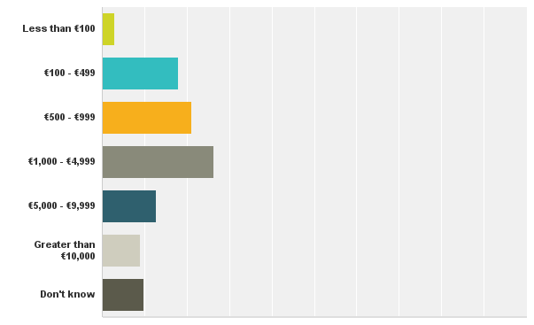
Q.10 – If drug-related, how much money was involved?
3%
18%
21%
26%
13%
9%
10%

Slide 13
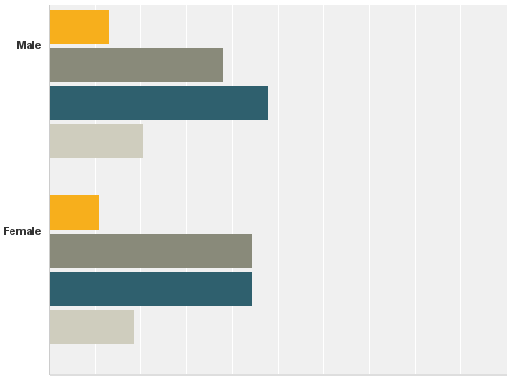
Q.11 - Gender and approximate age of those carrying out incidents:
13%
15-17
38%
18-25
Male: 81%
Female: 19%
48%
26-35
21%
Over 35
11%
15-17
Groups: 70%
Individuals: 30%
44%
18-25
44%
26-35
19%
Over 35

Slide 14
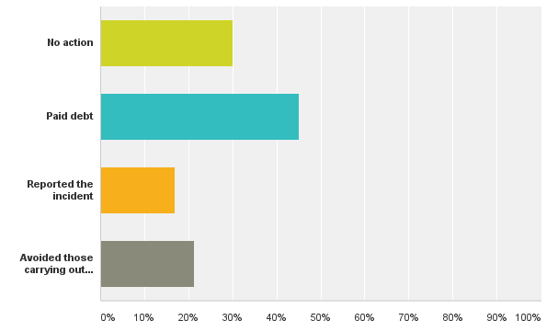
Q. 12 – What action did victims/families take in response to the incident?
30%
45%
17%
21%

Slide 15
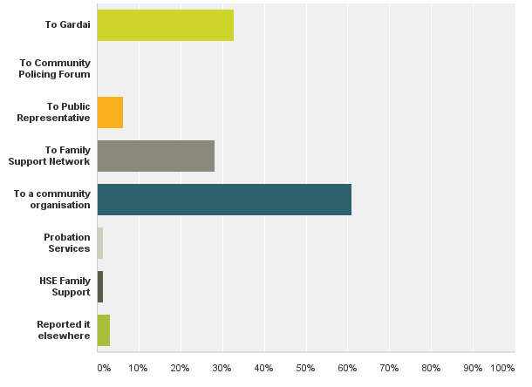
Q. 13 – If the victim/family previously reported the incident, who did they report it to?
32%
6%
28%
61%
2%
2%
3%

Slide 16
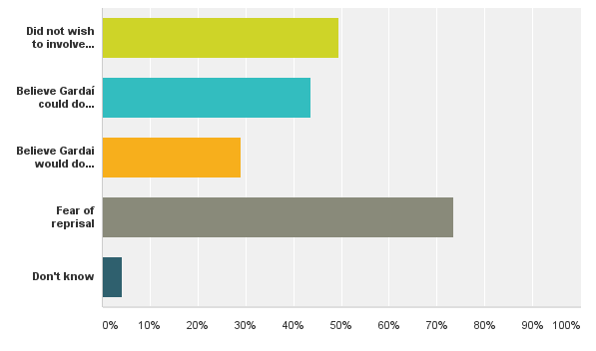
Q. 15 – If they didn’t report it to Gardai, why not?
50%
44%
29%
74%
4%

Slide 17
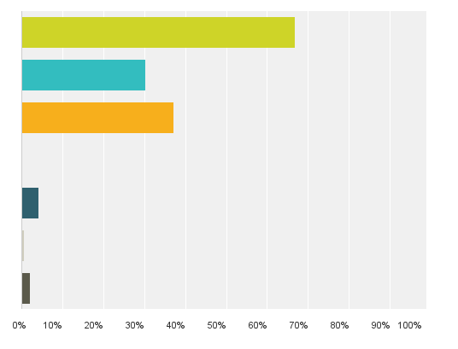
Q.16 – Consequences of incident:
Health/Wellbeing
Mental Health Issues
Other Health Issues
Physical Injury
Sexual Harm
Permanent Disfigurement
Suicide
Death
67%
30%
37%
4%
1%
2%

Slide 18
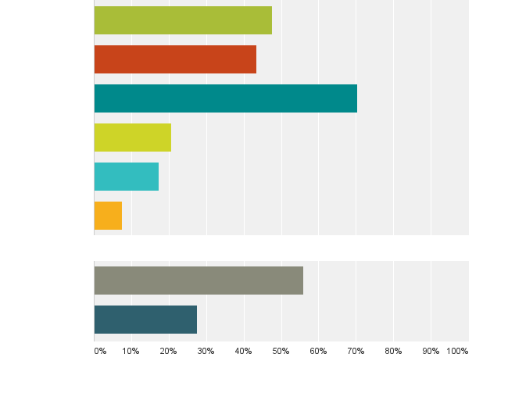
Home and Family
Family/Relationship breakdown
Fear for children’s safety
Fear for personal safety at home
Temporarily leave home
Permanently leave home
Homelessness
Money problems
Engaged in illegal activities to repay drug debts
48%
43%
70%
21%
17%
8%
Finance
56%
28%

Slide 19
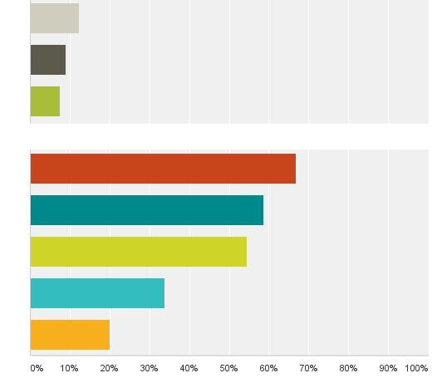
Work
Increased workplace stress
Fear for personal safety in work
Left employment due to fear
Fear for safety in local area
Avoid certain areas
Avoid certain people/families
Social Isolation
Forced to engage in illegal activities
12%
9%
8%
Social
67%
59%
54%
34%
20%

Slide 20
Focus Groups
Emerging themes from analysis of focus group data...

Slide 21
Victims and Perpetrators
Debt has to be paid, fear and respect generates income
There is a large middle group who maintain control
Intimidating families is a way of flushing the drug user out

Slide 22
The victims can also be perpetrators; harass and/or threaten family members to pay debts.
Drug users are intimidating vulnerable people to pay for their own drugs.
Dealers who source drugs on credit are under threat from suppliers, threat is passed on to customers/users: hierarchy of coercion

Slide 23
Young People
Young people are getting into huge debt over weed; coerced into ‘working the debt off’
There is intimidation in schools as young people are geographically far from each other outside of school. This is treated as bullying but nothing much is being done about it.
Fear of attack over debts is a cause of early school leaving.
Some young people carry weapons to school.

Slide 24
How can schools best respond? What procedures are in place?
Young people in the area have been forced to hold drugs. They have been caught by Gardai, they then have a bill to pay.
Youth and community workers notice behavioural changes in young people; hear stories about victimisation; self harm; suicide attempts
Some young people are anxious about family members who are taking drugs and being intimidated

Slide 25
Reporting
Youth workers feel their hands are tied because parents tell them about intimidation and they don’t know if they should tell them to go to the Gardai, pay up or face the consequences.
There is a belief that nobody can do anything including the Guards. They know that if someone goes to prison they will get back out quickly.

Slide 26
Protection fear
Some parents will contact projects or groups but don’t want it to go further.
Fear of reprisal is stopping people from reporting intimidation
Workers are afraid to speak with gardai about threats or violence that has been directed against them

Slide 27
Finances
People are struggling to pay debts and using loan sharks.
People have sold their houses to pay off drug debts and can’t get on to social housing lists because the Council believe that they should have the proceeds of the sale to pay for accommodation.
Interest or ‘waiting money’ is widespread; Debts can be sold on to collectors so payment increases

Slide 28
Parents get a variety of responses depending on who is intimidating them. Paying can perpetuate the problem.
Incidents are ongoing where families pay a debt and then drugs are offered to users on credit again because they know they will pay and another debt is accrued.
Families are paying debts even when no direct threat: consequences for non payment are clear

Slide 29
Community
Some flat complexes are no go areas. Staff feel threatened but won’t report.
Many in the community view the community workers as ‘rats’ and they often feel intimidated going to work.
The situation has had effects on community involvement. Fear prevents participation.
Non drug related crimes are not reported because the perpetrator may be part of a gang; fear of reprisal from drug dealers.

Slide 30
Conclusions
Fear of reprisal was the number one reason for not reporting; not reporting as the number one theme from the audit.
Demonstrates how drug crime is mediated by social class, poverty and deprivation. In most communities surveyed in nationwide victimisation polls non reporting of crime is rarely because of fear of reprisal. Huge challenge for community policing. How should the State respond: community safety structures require resources.

Slide 31
The social, emotional, and psychological stress that drug debt and the violent attention of dealers’ causes in the midst of poverty, disadvantage, austerity, and unemployment, needs to be emphasised in the strongest possible terms.
Top down system of enforcement where predatory individuals are making great profits.
Dominant drug dealers have tremendous power and communities are at a loss. People feel helpless. The power has to shift.

Slide 32
Thank You

