Slide 1
The UN General Assembly Special Session on Drugs & the shifting global drug policy landscape
Ann Fordham
Executive Director
12th November 2015
Citywide 20th Anniversary Conference
Dublin, Ireland

Slide 2
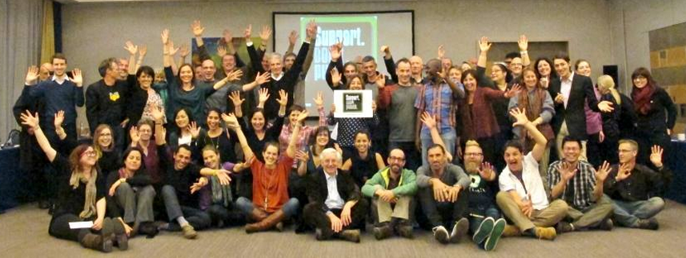
The International Drug Policy Consortium
A global network of 140+ NGOs from 60+ countries
Promoting the voice of NGOs in drug policy debates and facilitating their participation at key meetings
Promoting drug policies grounded in evidence, health, human rights, development, social inclusion, human security and civil society participation

Slide 3
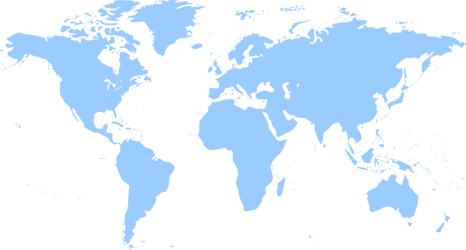
The United Nations General Assembly Special Session on drugs
What is it?
Why is it important?
What could be gained?

Slide 4
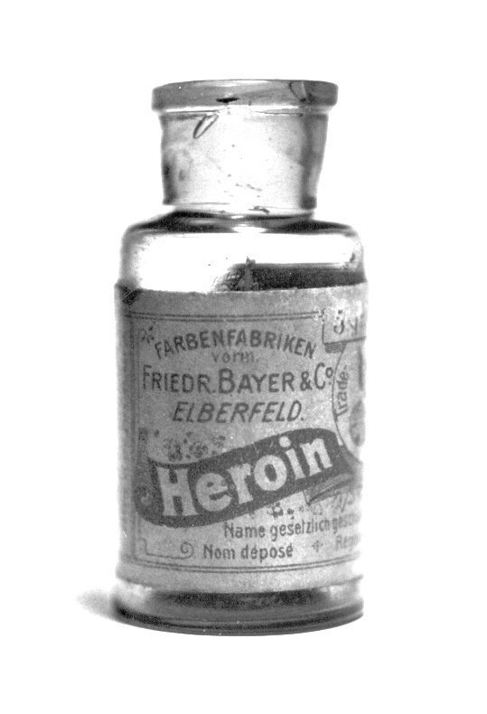
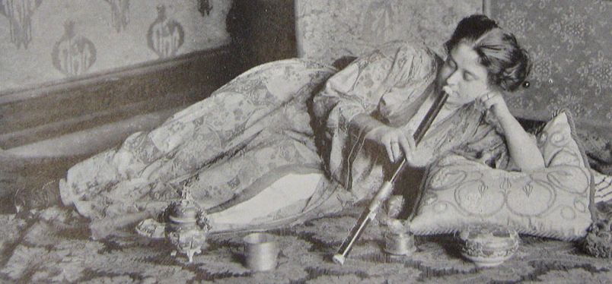
The UN drug conventions
Three conventions: 1961, 1971 and 1988
Prohibit supply and demand of drugs for non-medical purposes
Promote access for scientific and medical purposes
“Vienna consensus”: conventions signed onto by virtually all Member States
Strongly punitive ‘thrust’
Some flexibility

Slide 5
The UNGASS
General Assembly = highest policy-making and representative organ of the UN
UN General Assembly Special Sessions can be called by a majority of Member States or the Security Council
1947
Palestine
1990
Drug abuse
1998
World Drug
Problem
1999
Population & Development
2000
Millennium Summit (MDGs)
2001
HIV
2002
Children

Slide 6
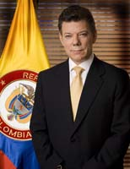
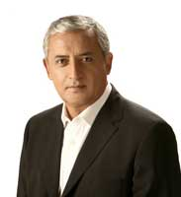
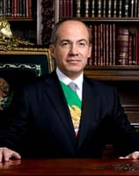
The 2016 UNGASS
Requested by the Presidents of Mexico, Guatemala, Colombia to give the issue urgency
Supported by 95 UN member states
More and more calls for drug policy reform…

Slide 7
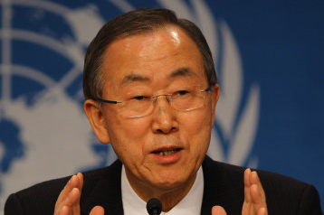
An opportunity….
“I urge Member States to use these opportunities to conduct a wide-ranging and open debate that considers all options.”
26th June 2013

Slide 8
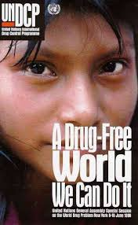
Notes:
Slogan at the last UNGASS….

Slide 9
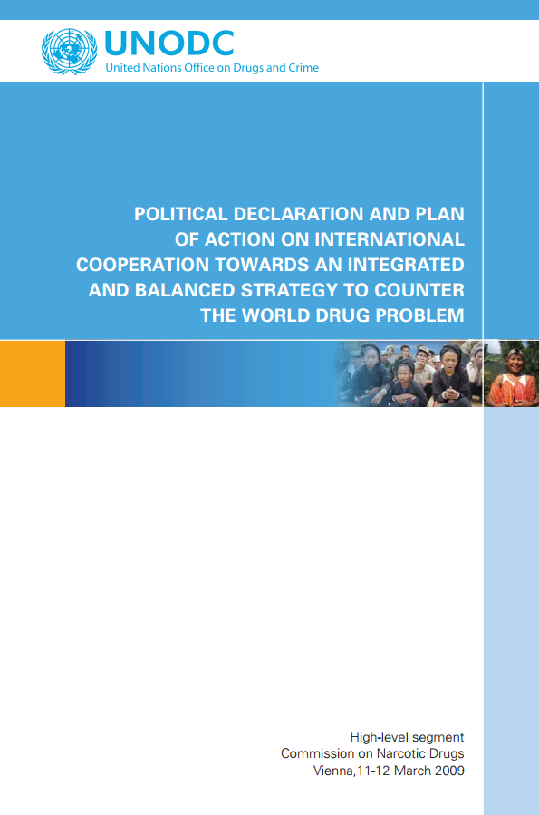
2009: Results, 10 years later, of the 1998 UNGASS objectives & Adoption of the Political Declaration and Plan of Action.
Objective: Eradicate or significantly reduce the global drug market by 2019
Key topics: demand reduction, supply reduction, reduction of crime and money laundering
2014: High Level Segment (5 year review) & adoption of Joint Ministerial Segment – ‘significant progress towards still distant goals’
2019: 10 year review of the objectives of the 2009 Political Declaration

Slide 10
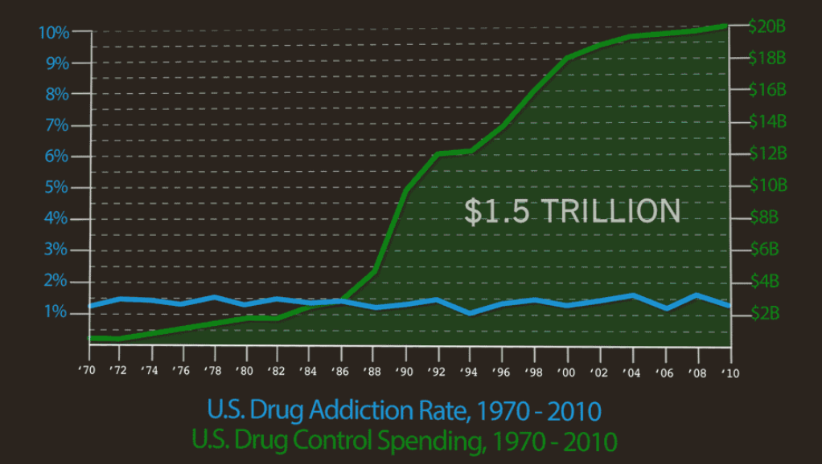

Slide 11
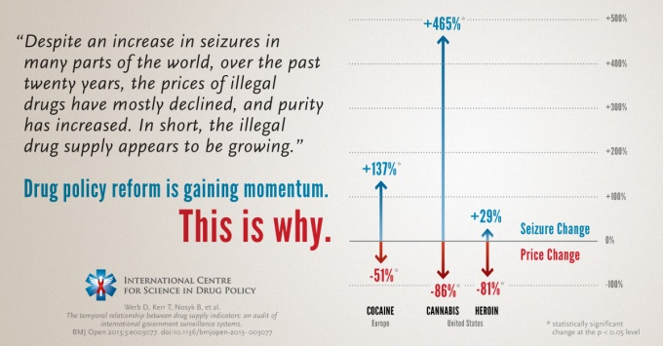
Notes:
Govt data over 10 years

Slide 12
“Unintended” negative consequences
$449bn to $674bn a year criminal black market (worth 5 times the global aid budget)
Public health is marginalized in favour of enforcement
Geographical displacement (balloon effect)
Substance displacement (new types of drugs)
Stigmatisation and marginalisation of people who use drugs
UNODC, 2008

Slide 13
Devastating consequences
Public health | Human rights
162 – 324 million people used illicit drugs 8.9 – 22.4 million people inject drugs | Use of the death penalty Extra judicial killings Disproportionate sentences
13.5% living with HIV & 50%+ Hep C Lack of access to ‘harm reduction’ measures | Compulsory detention as ‘treatment’ Police brutality
Lack of access to controlled medicines for millions of people | Violations of the cultural and traditional rights of indigenous groups
Severely underfunded health response | Widespread violence and insecurity
Notes:
162 – 324 million people used illicit drugs
Underfunded health responses
Lack of access to essential medicines

Slide 14
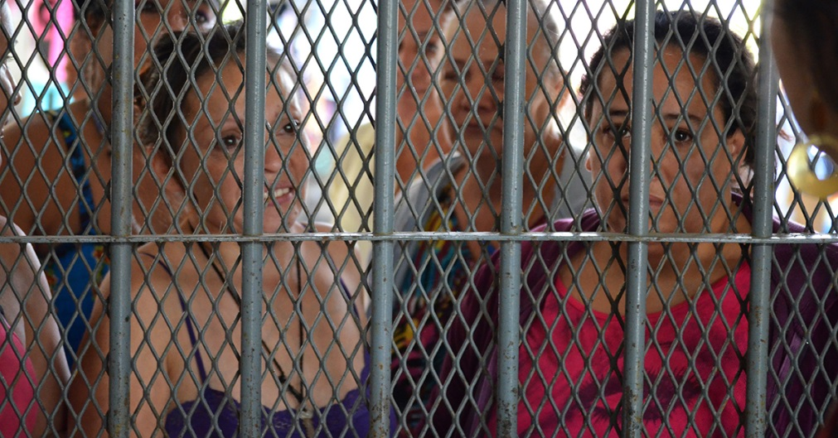
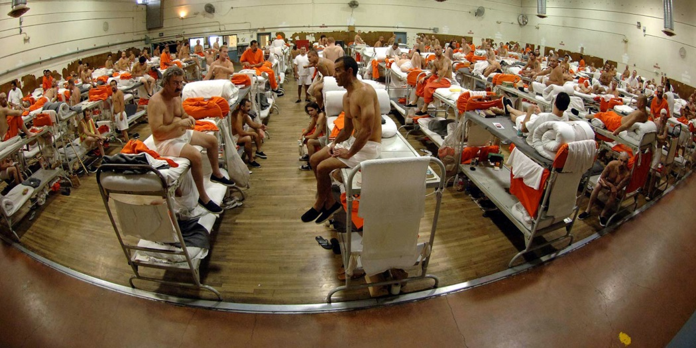
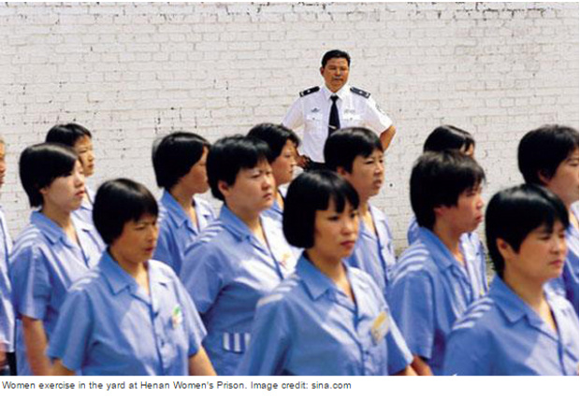
1 in 5 people sentenced to prison globally is for a drug offence – 80% for “possession” alone

Slide 15
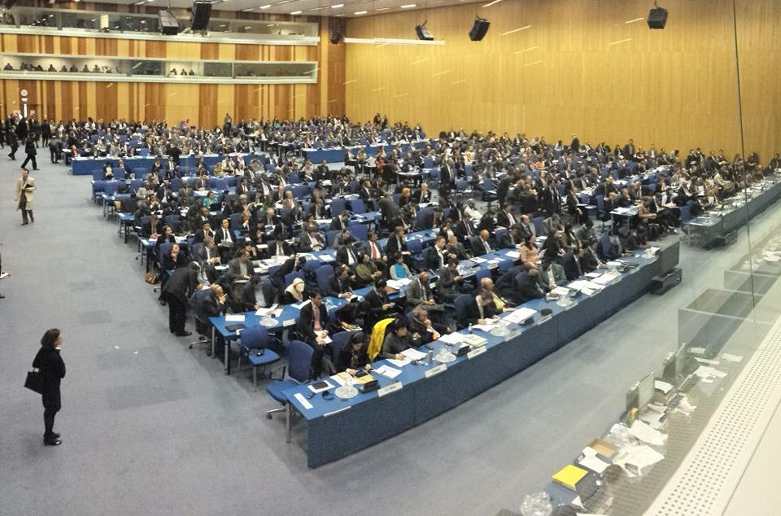
A fractured consensus….

Slide 16
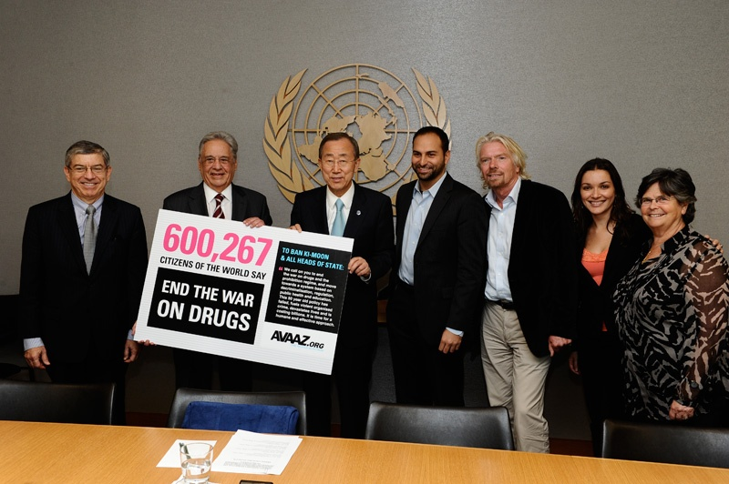
‘Breaking the taboo…’

Slide 17
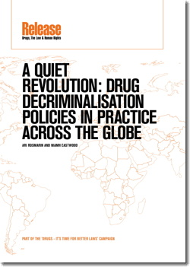
Decriminalisation: a quiet revolution
Armenia
Australia (state level)
Belgium
Brazil
Chile
Colombia
Czech Republic
Estonia
Germany
Italy
Mexico
The Netherlands (de facto)
Paraguay
Peru
Poland
Portugal
Spain
Uruguay
United States (state level)

Slide 18
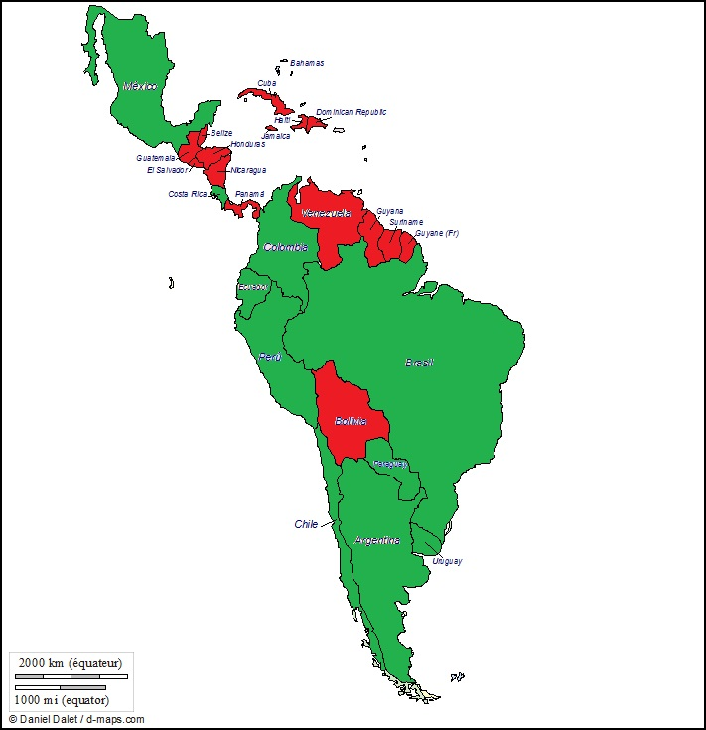
Decriminalisation in Latin America
2000
2010

Slide 19
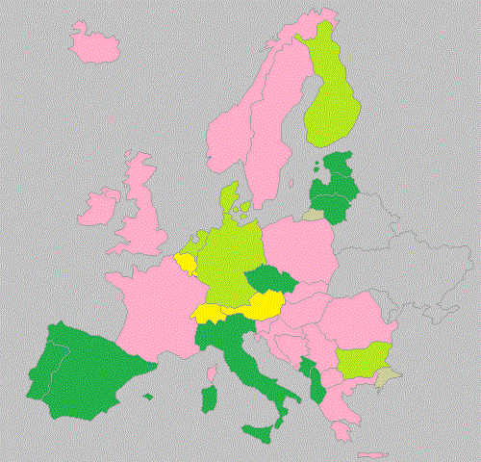
Decriminalisation in Europe
Possession for personal use
Criminal offence
Only cannabis decriminalised
De facto decriminalised
De jure decriminalised
Based on available EMCCDA data

Slide 20
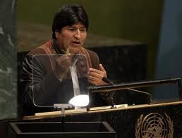
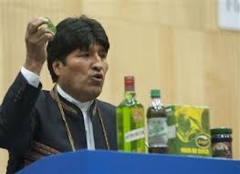
Breakthrough: Bolivia & coca leaf
Denunciation & re-adherence with reservation
‘Integrity’ of the treaty system challenged
Reconciliation drug control & human rights

Slide 21
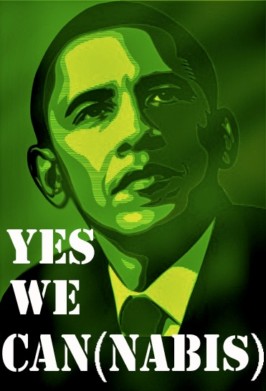
Cannabis - USA

Slide 22
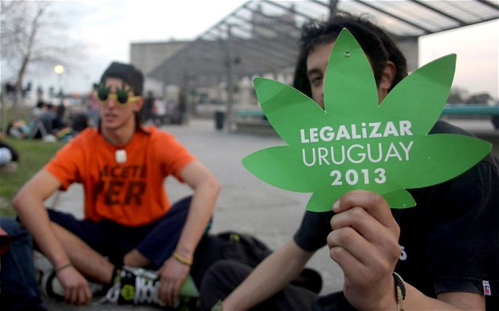
Uruguay

Slide 23
Canada?

Slide 24
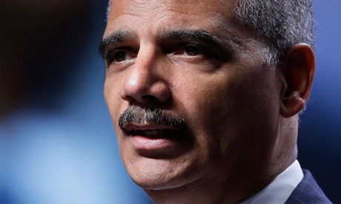
"Too many Americans go to too many prisons for far too long and for no truly good law enforcement reason…. We cannot simply prosecute or incarcerate our way to becoming a safer country."
Notes:
Holder also announced a review into sentencing disparities, pointing to a recent study showing black male offenders received sentences nearly 20% longer than whites convicted of similar crimes. "This isn't just unacceptable, it is shameful," said Holder.

Slide 25
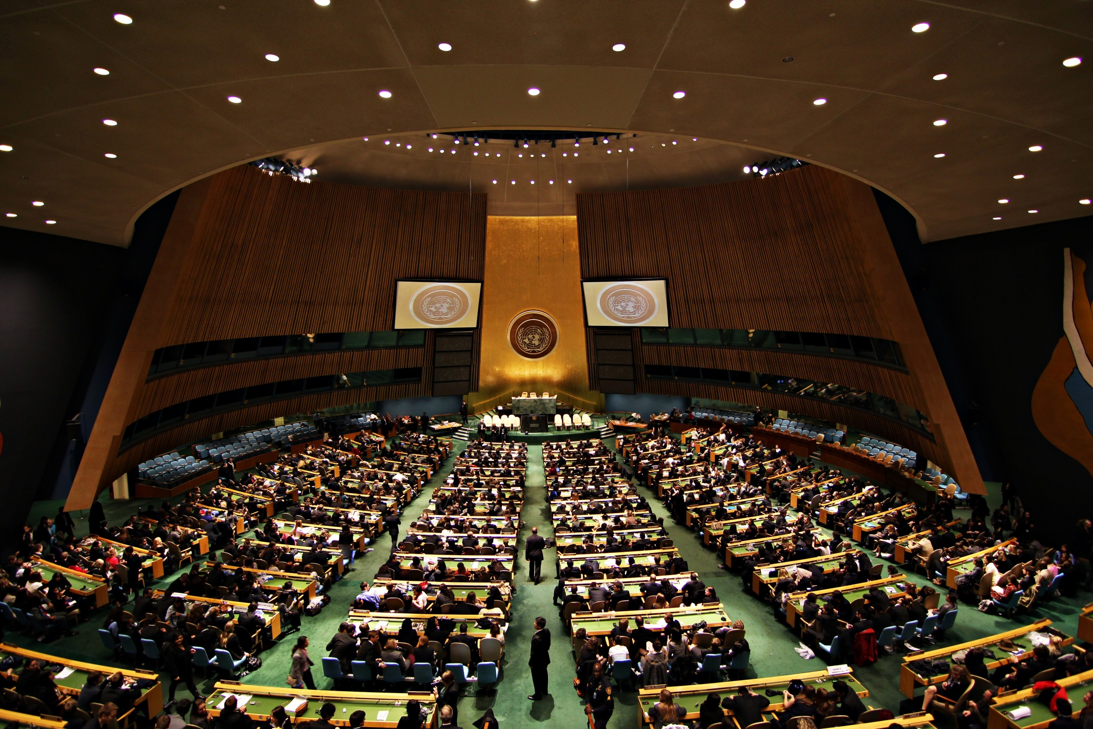
What might we gain?

Slide 26
“Declare that people who use drugs should receive support, treatment and protection, rather than be punished.”
From the USA’s contribution to UNGASS outcome document

Slide 27
Proportionality of sentences

Slide 28
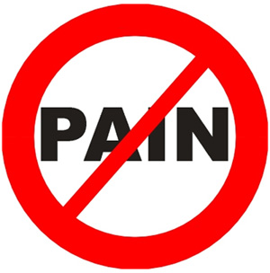
Access to essential medicines

Slide 29
Other areas of debate?
Ending the death penalty for drug offences = stronger human rights language
‘harm reduction’ – expand definition?
More attention to the development / socio-economic dimension
Reassess the indicators by which we measure success

Slide 30
EU presence in the global debate
Common position: strong voice EU
Alternative Development: proper sequencing
Harm reduction: always include
Human rights: death penalty

Slide 31
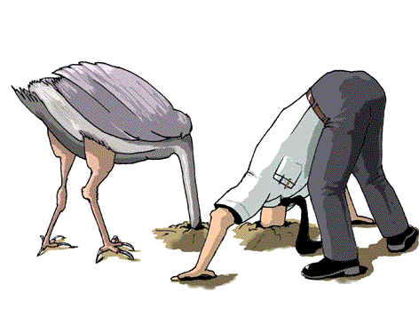
EU absence in the global debate
‘Evidence-base’ for drug law enforcement?
Cannabis: avoiding the debate
War on drugs & violence: not EU’s problem?
UN conventions: denial of inconsistencies
Lack of visibility in UNGASS process

Slide 32
Europe & the UNGASS
Action Plan 2013-2016: “Contribute to shaping the agenda on international drugs policy”
Emphasis on human rights, harm reduction and alternative development
New Psychoactive Substances
Access to essential medicines
Cannabis regulation in Europe?
2016 UNGASS: an honest debate that considers all options?

Slide 33
IDPC’s UNGASS ‘Asks’

Slide 34
THANK YOU! afordham@idpc.net www.idpc.net

